Slide 1
O = 6 Mechanical
Design Notes
Yizhu Gu

Slide 2




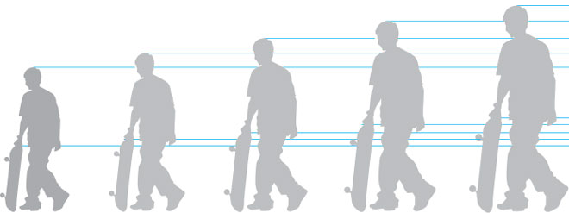
Design Goal
Six legs good, Eight legs bad
I am a complete system
Taller, stronger
Notes:
Hexapod Robot
Self Contained Units
Electrical motor, no hydraulics
As tall as it can be

Slide 3
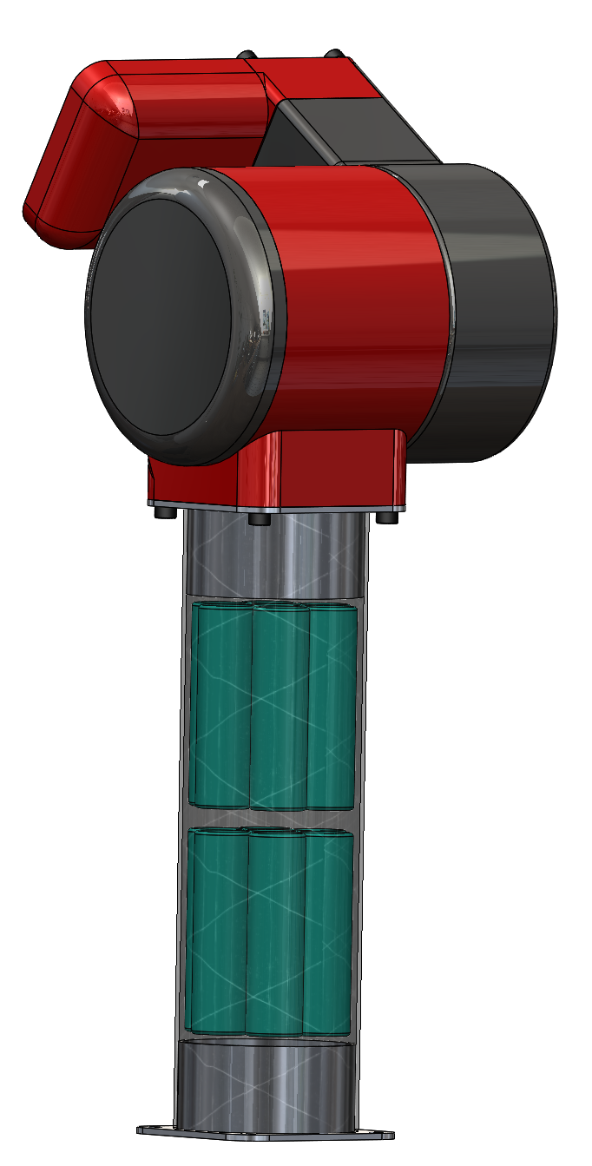
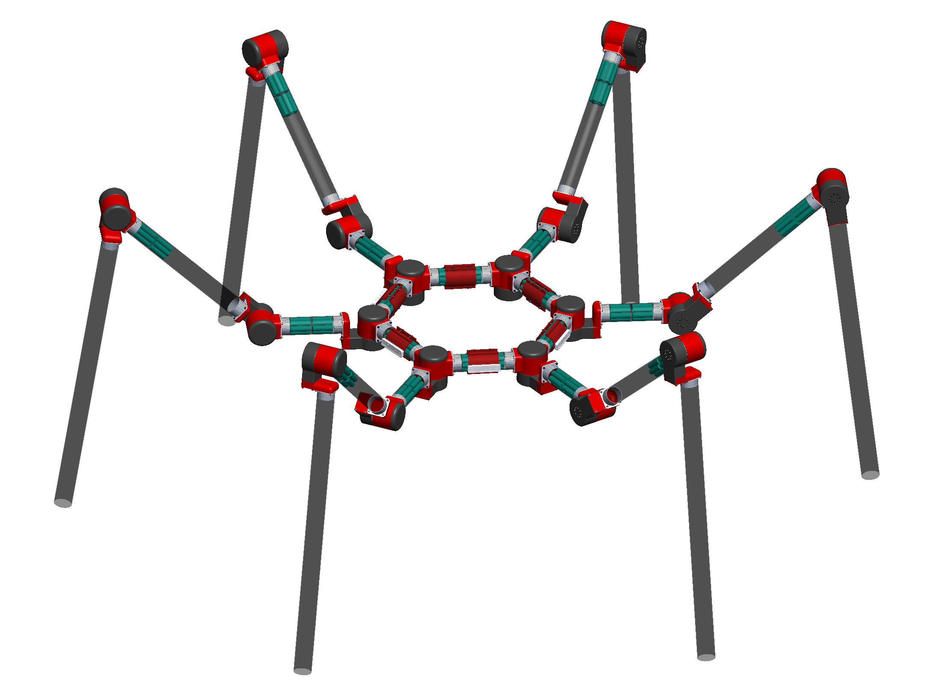
Design Goal
PI#1910066
1m

Slide 4
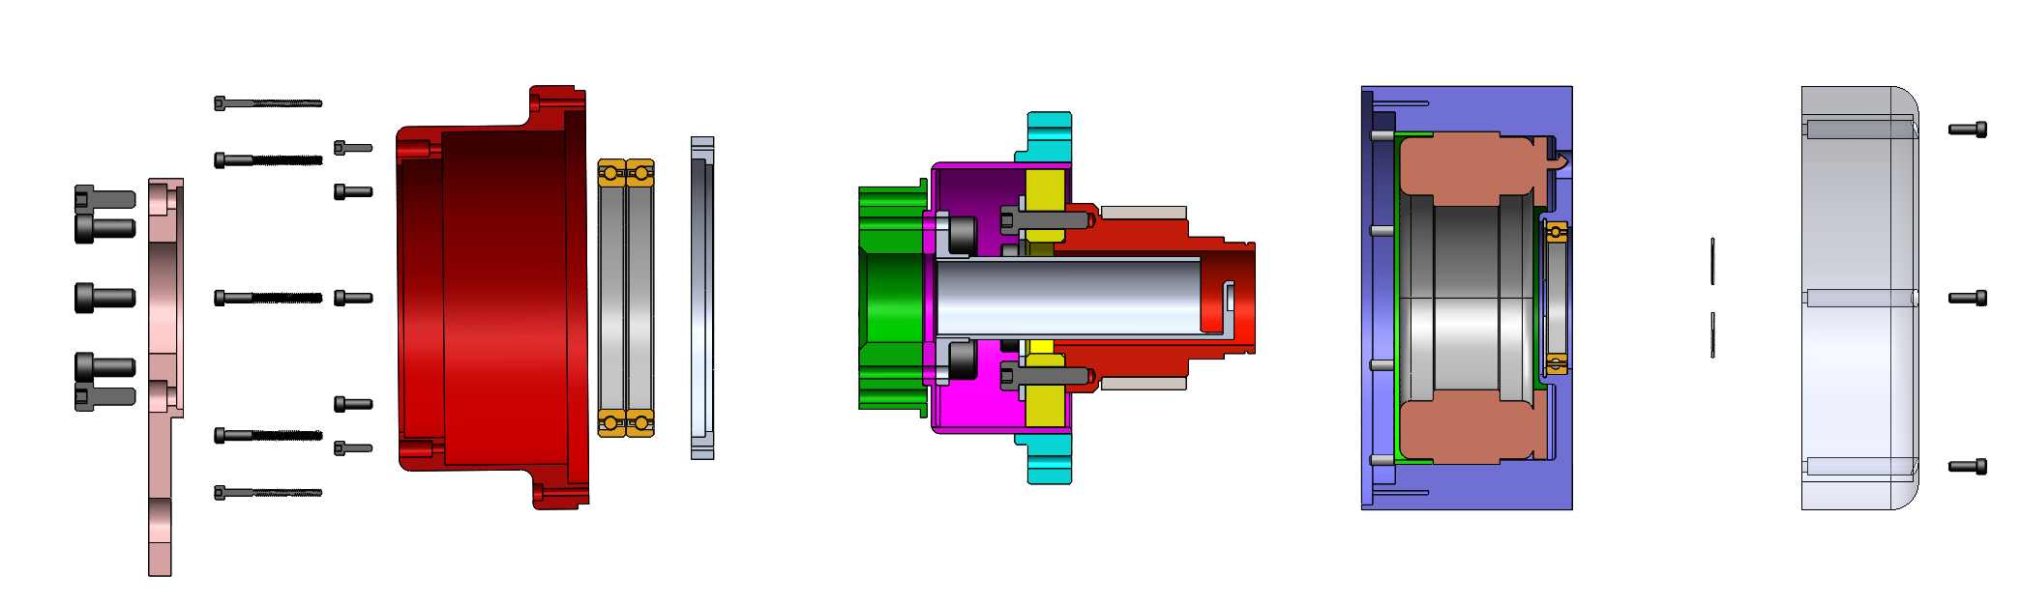
Assembly
Transmission:
Harmonic gearbox with accessories
Input:
Motor with hollow shaft
Electronics
Output casing and support

Slide 5
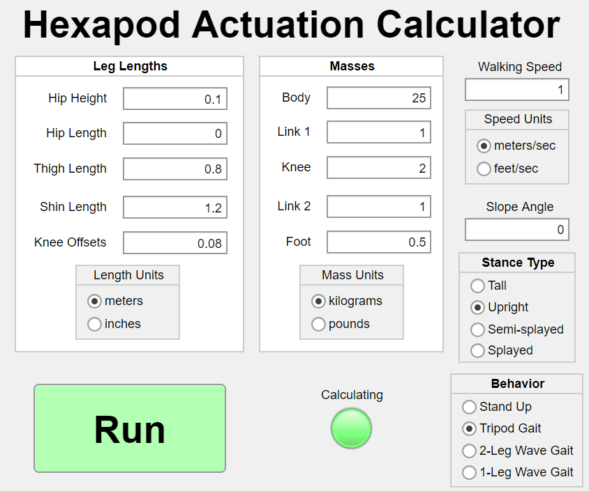
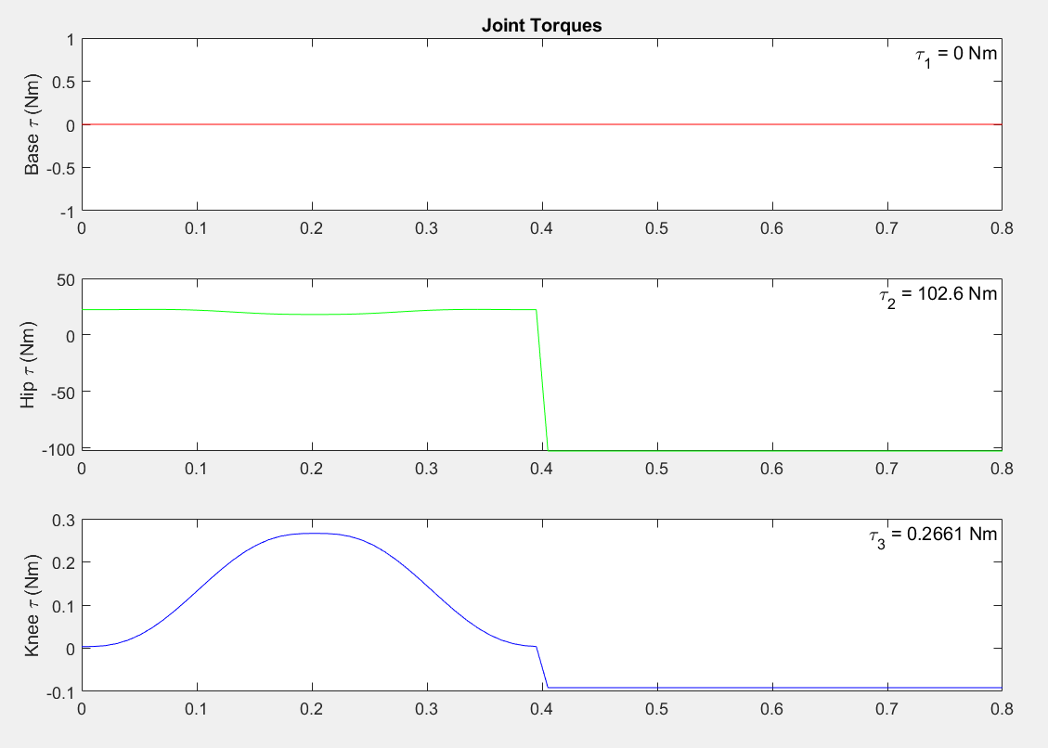
Parameter Requirements
100 Nm - torque output
2 Kg - Each “knuckle” unit less than 2kg (W/O battery)

Slide 6
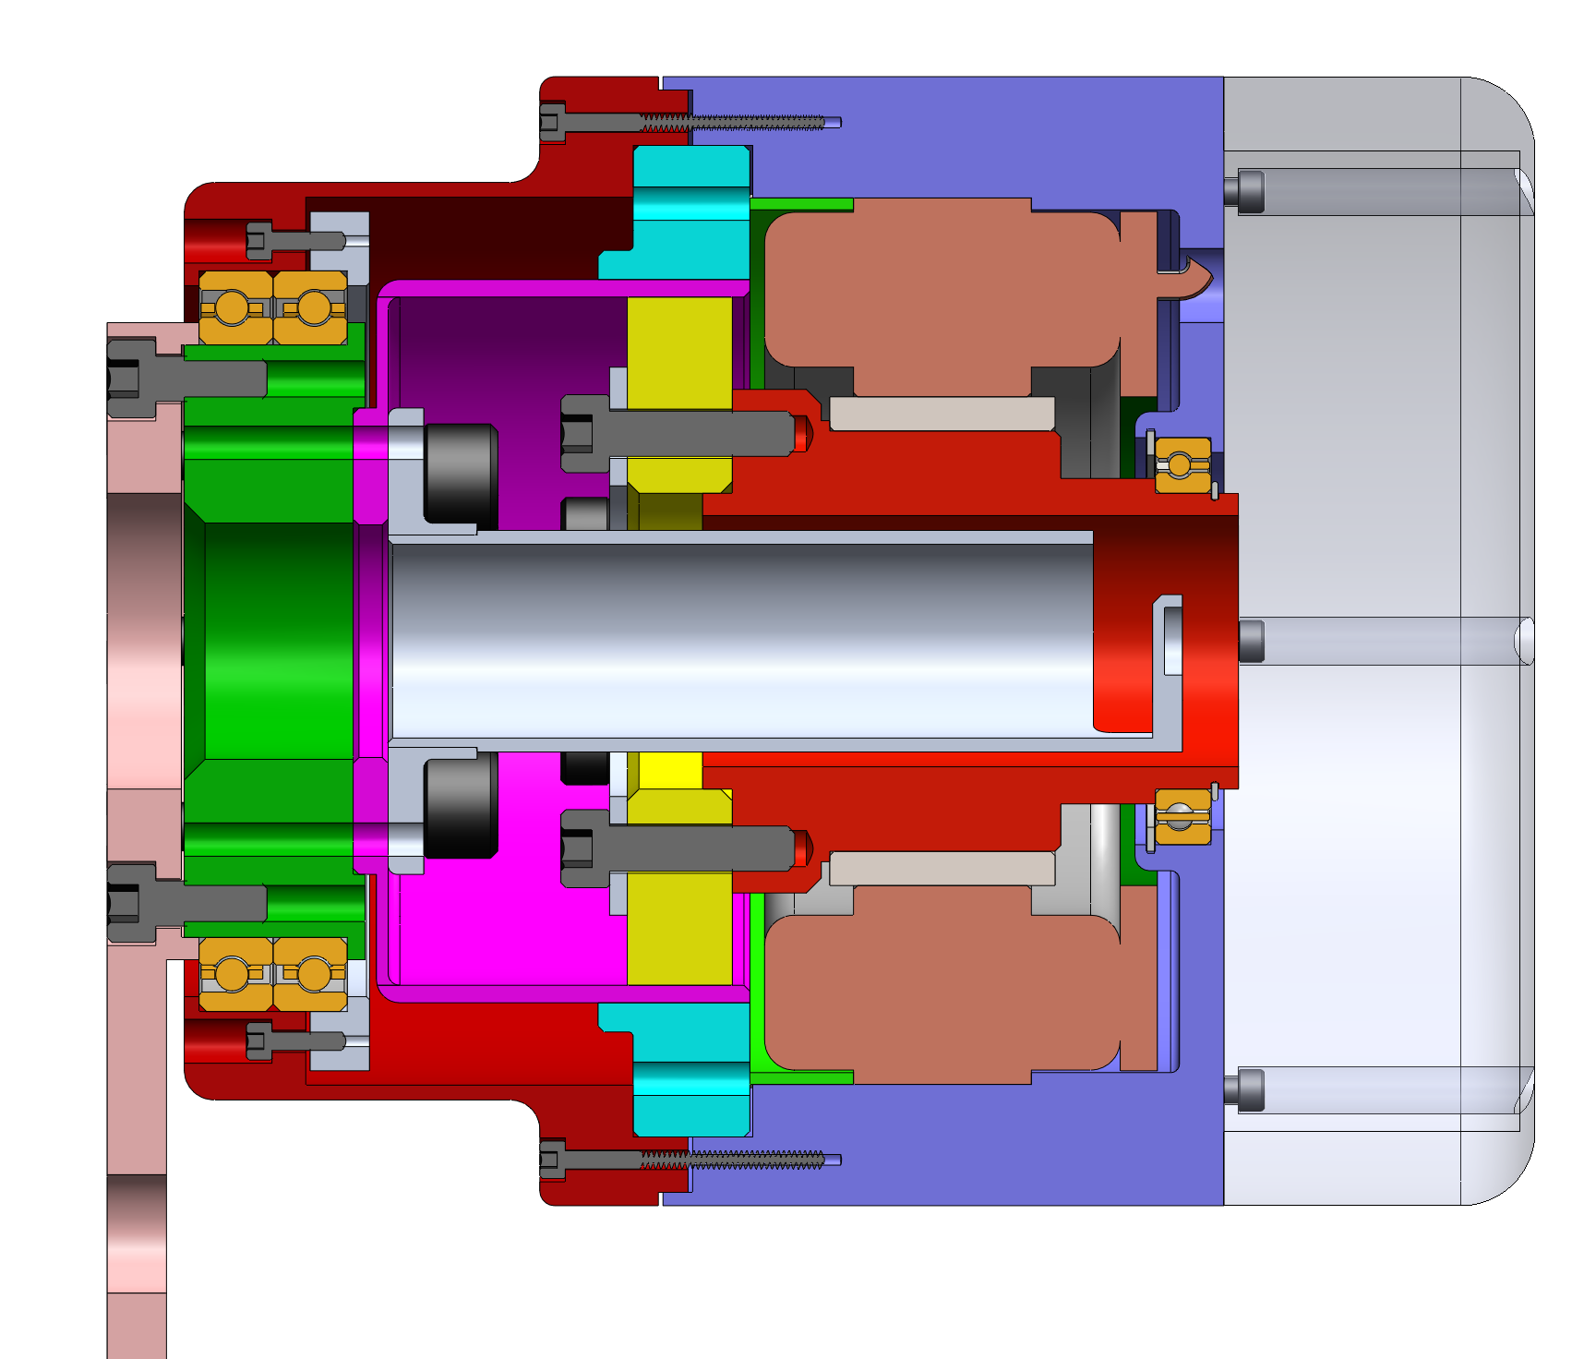
Design Overview
4”
OD: 4”
Lg: 4” (W/O electronics)
Mass: 1.8 kg (unoptimized)
Output torque: 70Nm/100Nm
Ø = 4”

Slide 7
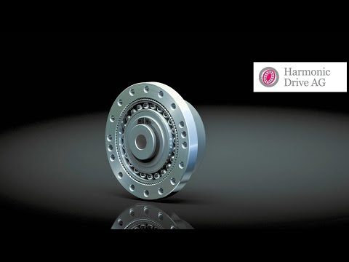
Assembly

Slide 8
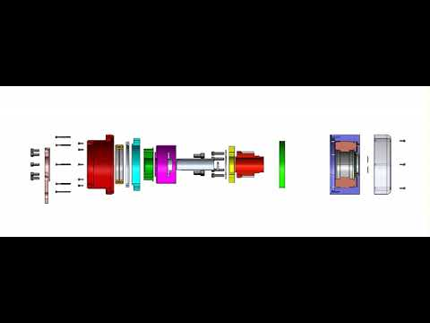
Assembly

Slide 9
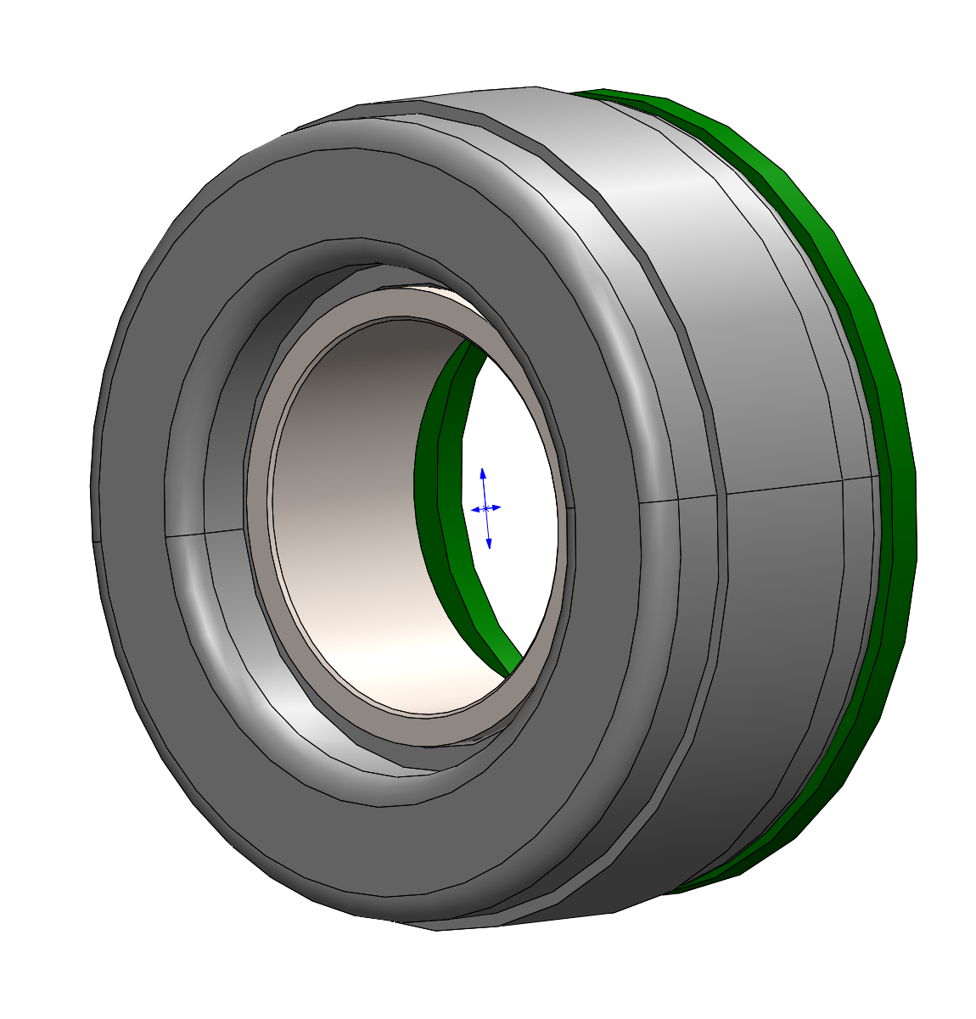
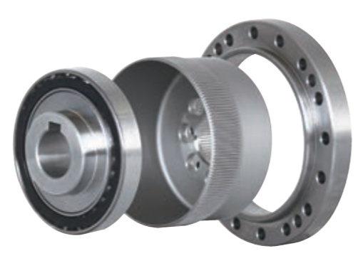
Components
Kollmorgen Frameless Motor
Output Torque: 0.939 Nm (cont. stall)
Mass: 435g
Shimpo Drive Gearbox
Gear Ratio: 100:1
Output Torque: 70Nm/163Nm
Mass: 430g

Slide 10
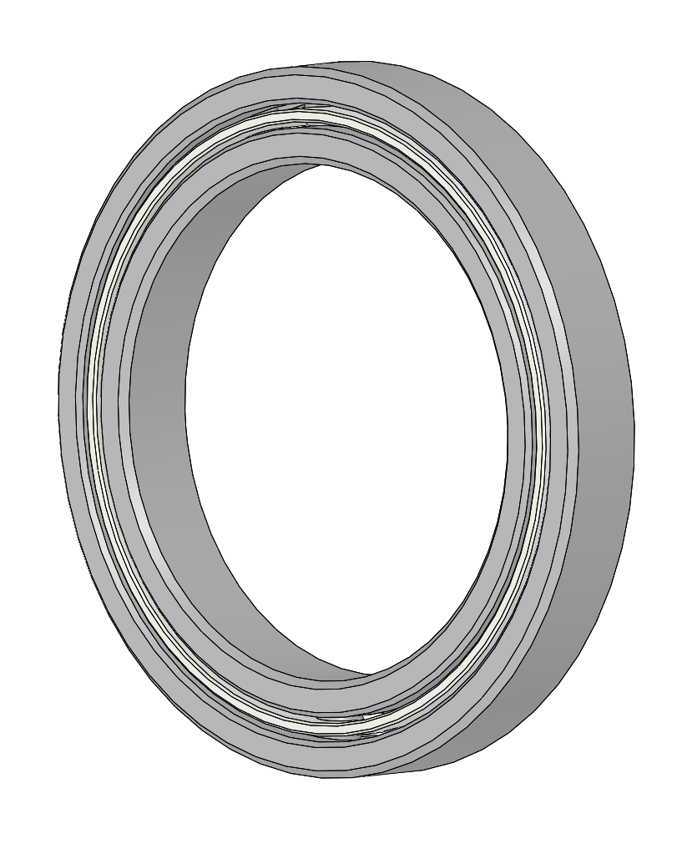
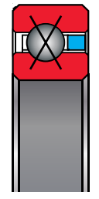
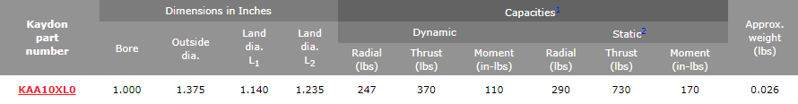
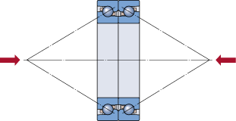
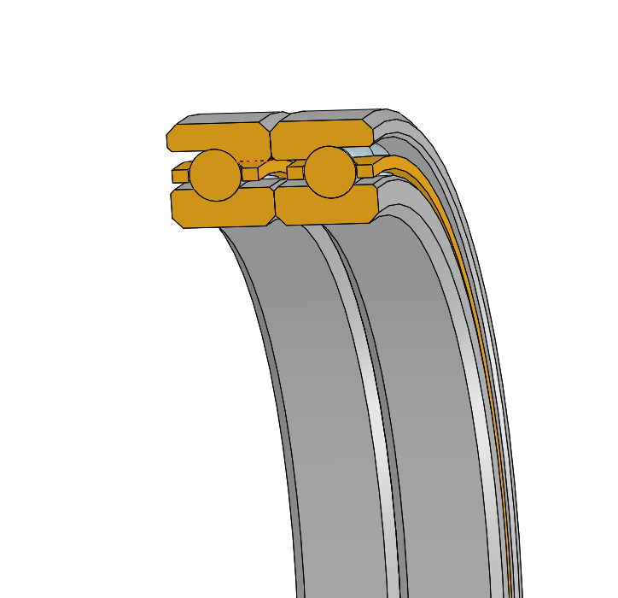
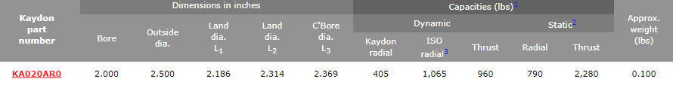
Components
Input Bearing
Output Bearing (double, DB mounting)
Compare with crossed roller bearing has higher performance under moment load

Slide 11
Bearings
Bearing type | Crossed-roller | Double A
Bearing | IKO CRBT505A | KA020AR0
Bore | 50 mm | 2 in
ID | 61 mm | 2.5 in
Width | 5 mm | 0.25 in
Moment Load | 60 Nm
Allowable | 16 Nm
Static Moment |  | 138 Nm
Dynamic Moment |  | 70 Nm

Slide 12
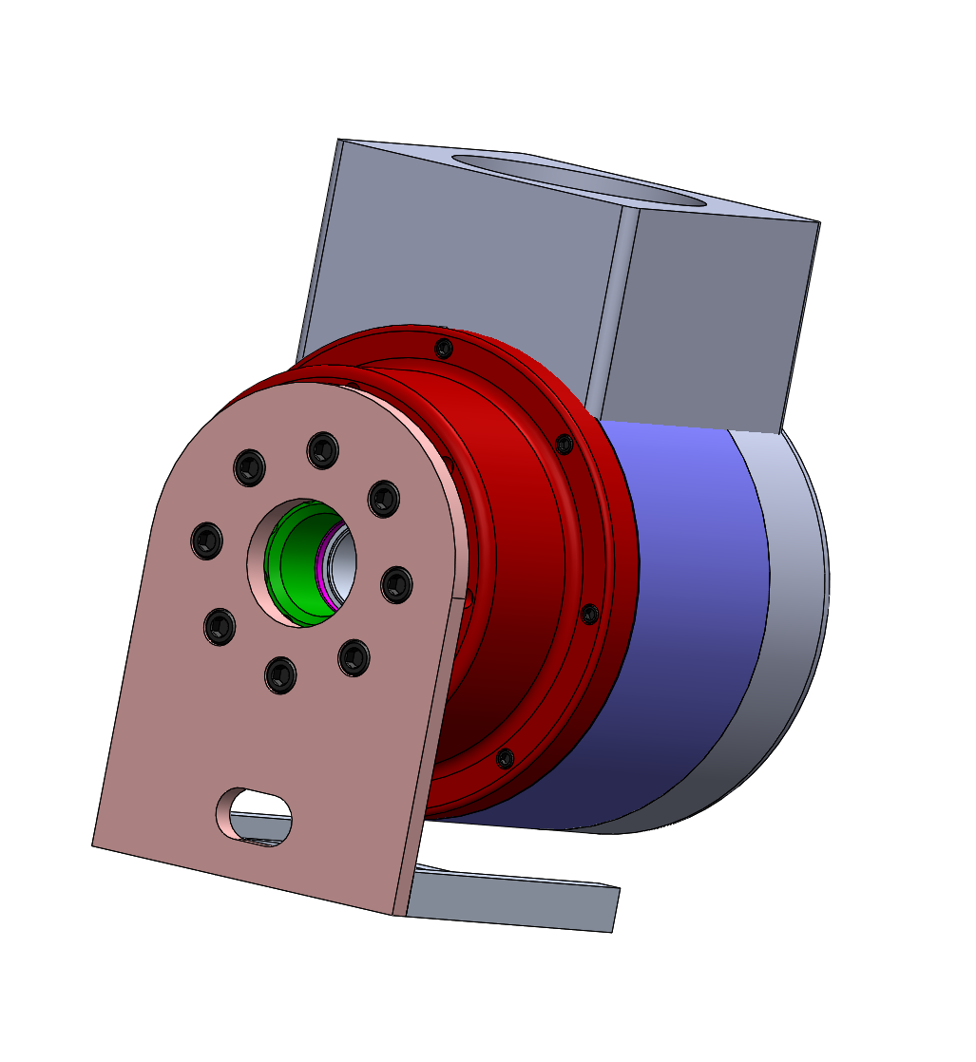
Next Step - Large Scale
Leg connection and cable routing

Slide 13
Next Step - Details
Thermal (thickness of the case)
Weight reduction
Tolerance
Drawing
Assembly jig design

Slide 14
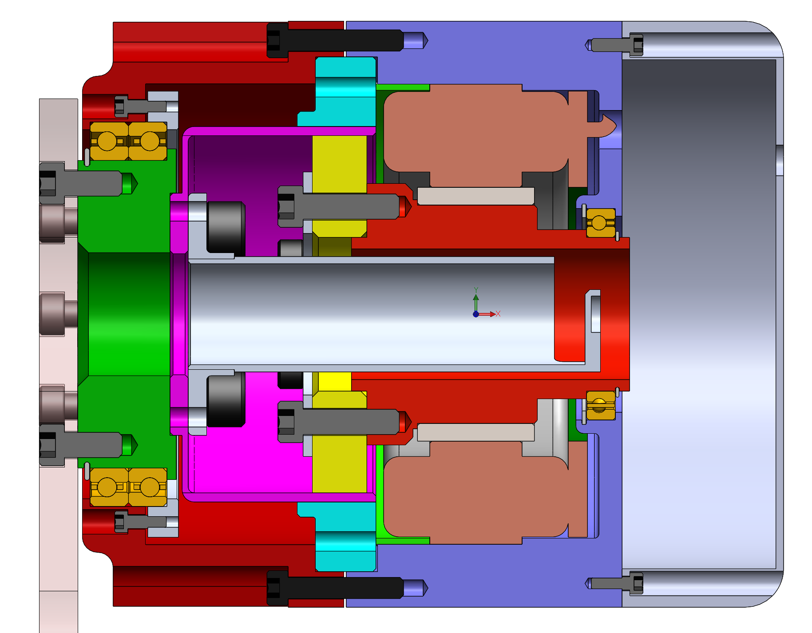
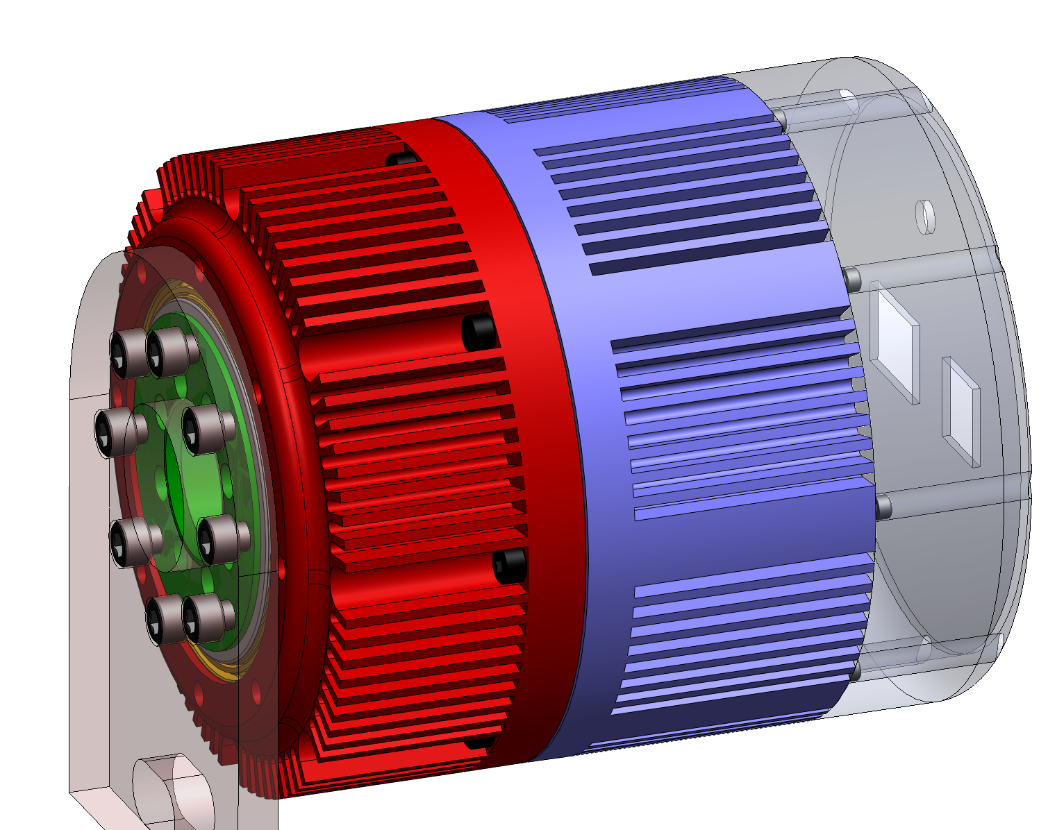
Post Design Review Changes
Bearing comparison
Continuous rotation
Output plate
Screw Sizes
Heat sink (thermal)

Slide 15
Bearing Comparison
Bearing type | Crossed-roller | Double A
Bearing | IKO CRBT505A | KA020AR0
Bore | 50 mm | 2 in
ID | 61 mm | 2.5 in
Width | 5 mm | 0.25 in
Moment Load | 60 Nm
Allowable | 16 Nm
Static Moment |  | 138 Nm
Dynamic Moment |  | 70 Nm

Slide 16
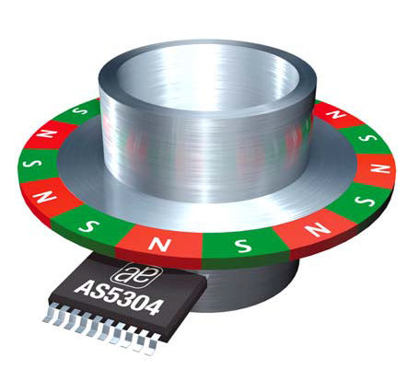
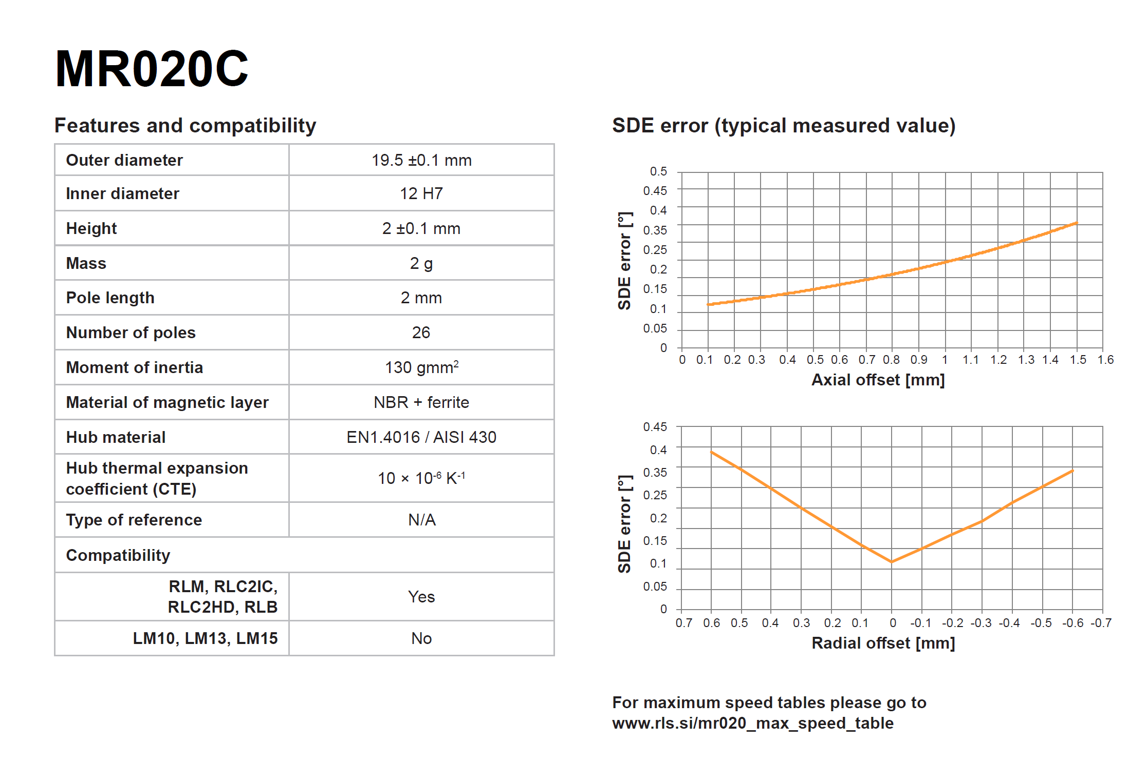
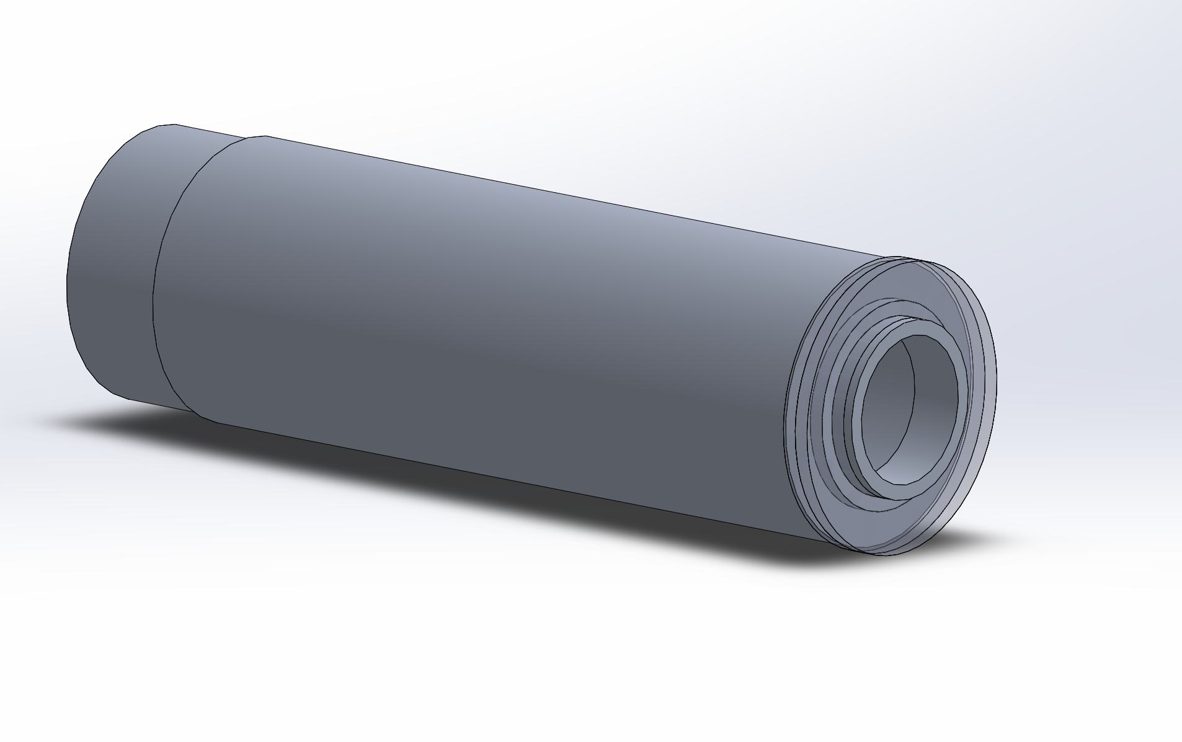
Continuous Rotation
ID for wire pass through: 10mm

Slide 17
Thermal Analysis
To figure out:
Heat generation from motor and gearbox
Surface Area of heat sink
Volume of heat sink

Slide 18
Motor Thermal Calculation
Steady state
Friction loss: W_c = (F_T * w) + (B * w^2)
Damping loss: W_r = 1.5 * (I_rms)^2 * R_hot
Parameters:
F_T = 0.013 Nm (cogging friction, viewing it as all the friction we have from the system)
w = 3930 rpm (speed at rated power)
B = 6.05E-3 (viscous damping)
I_rms = 10.5A (continuous current)
R_hot = 0.56 Ohm (Winding resistance at winding temp. R_hot = R_25°C*(0.90175+0.00393*T_w), T_w = 155°C)

Slide 19
Motor Thermal Calculation
Extreme case (stall)
Friction loss: W_c = (F_T * w) + (B * w^2)
Damping loss: W_r = 1.5 * (I_rms)^2 * R_hot
Parameters:
F_T = 0.013 Nm (cogging friction, viewing it as all the friction we have from the system)
w = 3930 rpm (speed at rated power)
B = 6.05E-3 (viscous damping)
I_rms = 36.0A (peak current)
R_hot = 0.56 Ohm (Winding resistance at winding temp. R_hot = R_25°C*(0.90175+0.00393*T_w), T_w = 155°C)

Slide 20
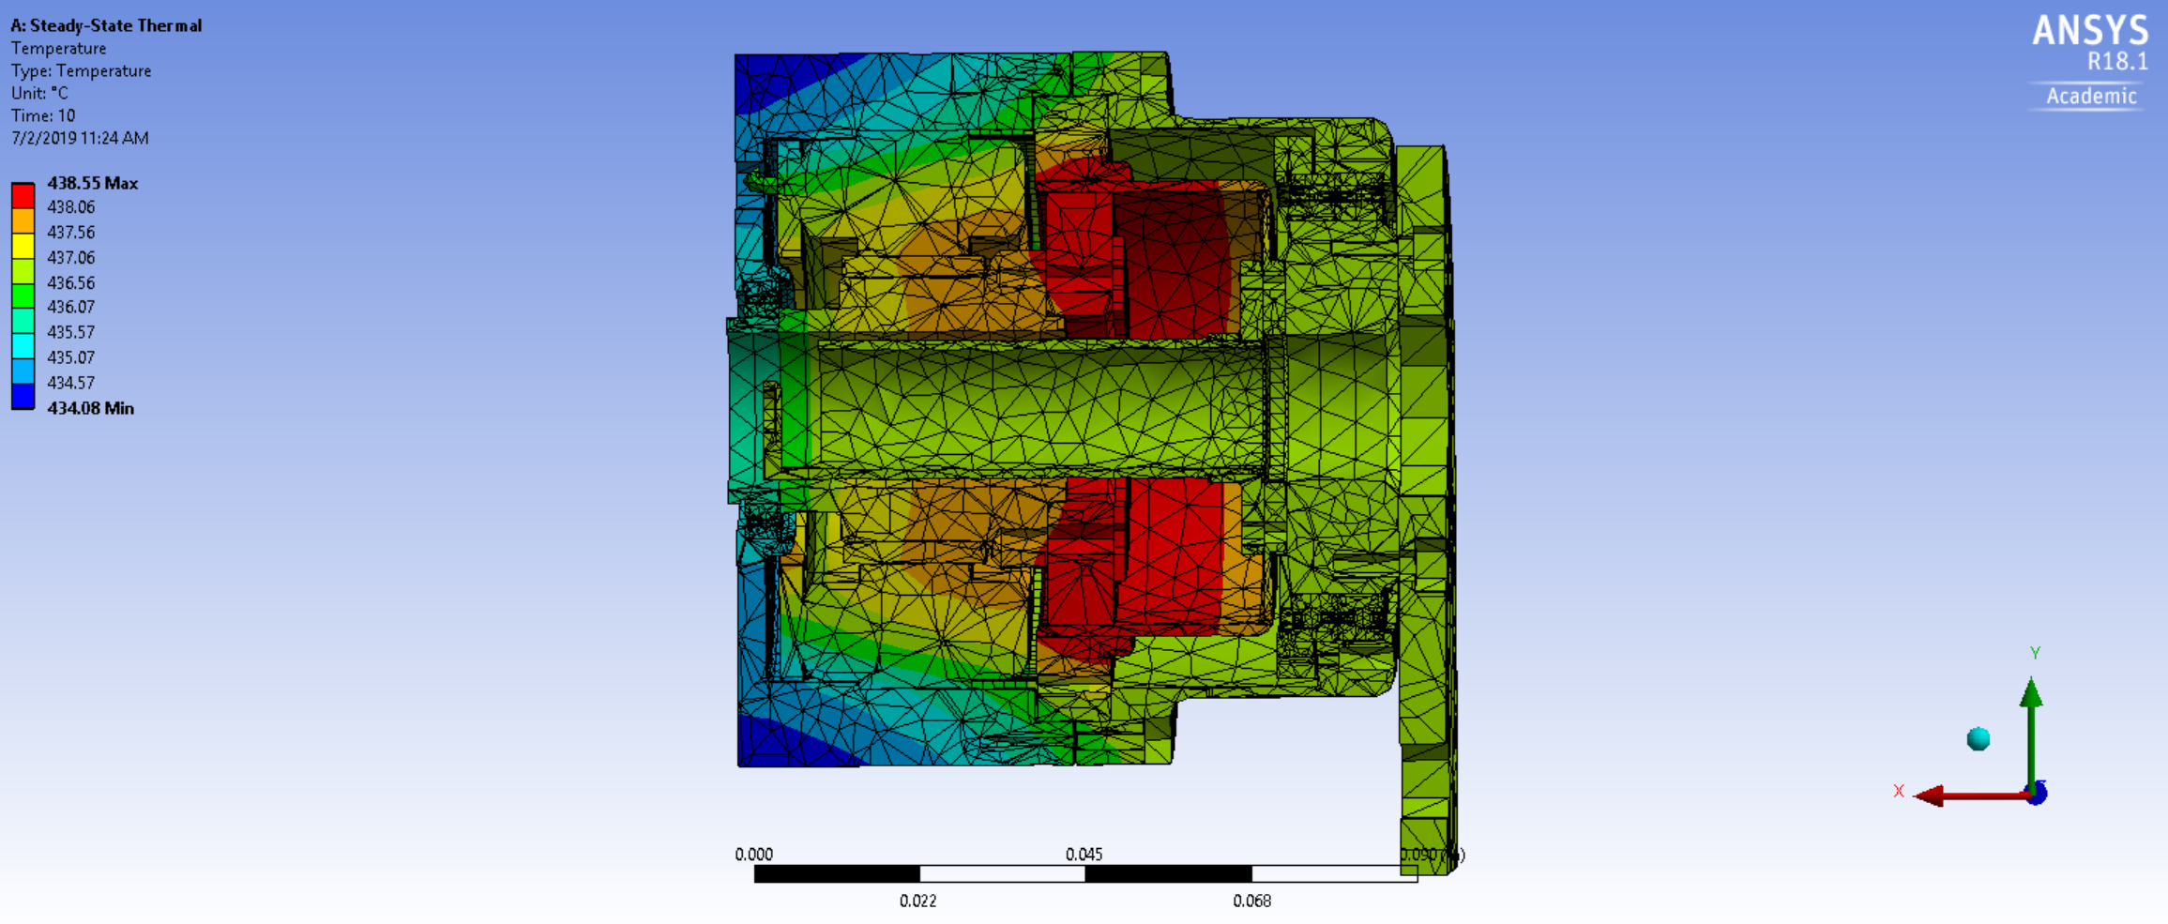
Previous Design Steady State Analysis

Slide 21
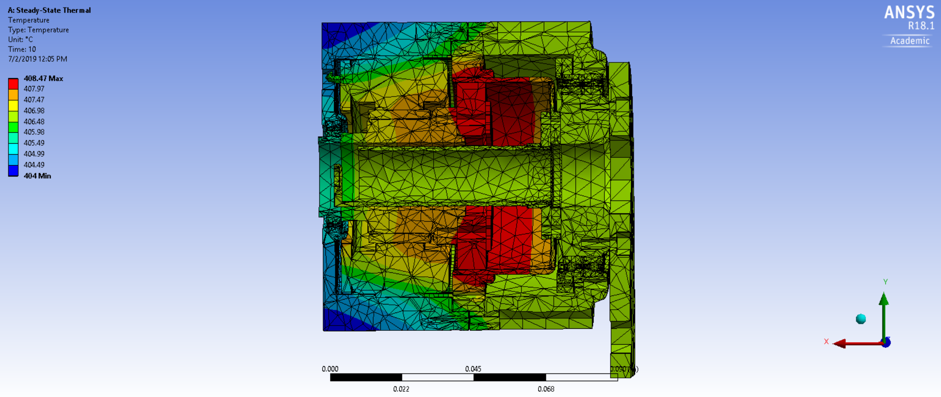
Slight Air flow

Slide 22
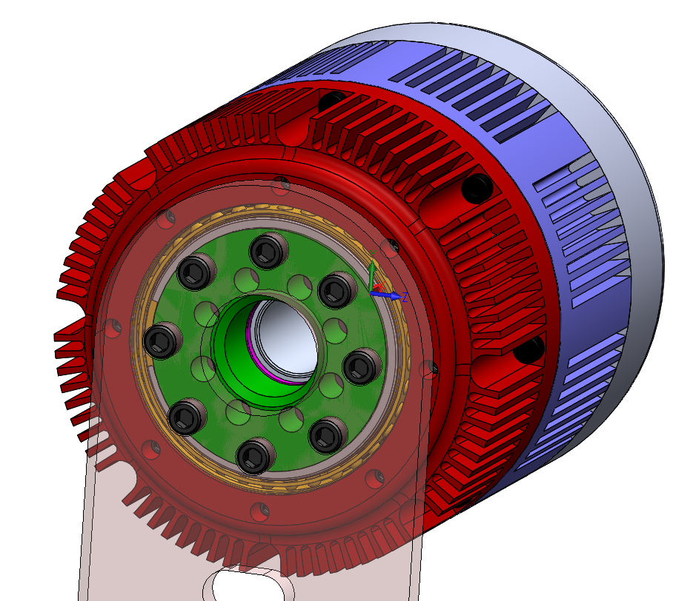
Heat Sink

Slide 23
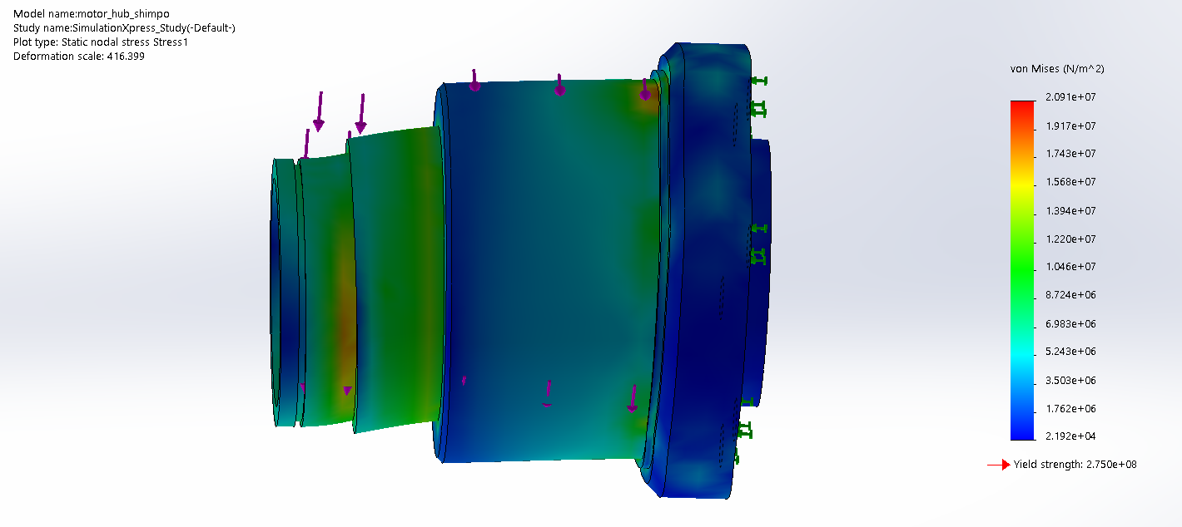
Stress Analysis
6 Nm torque
1000 N load

Slide 24
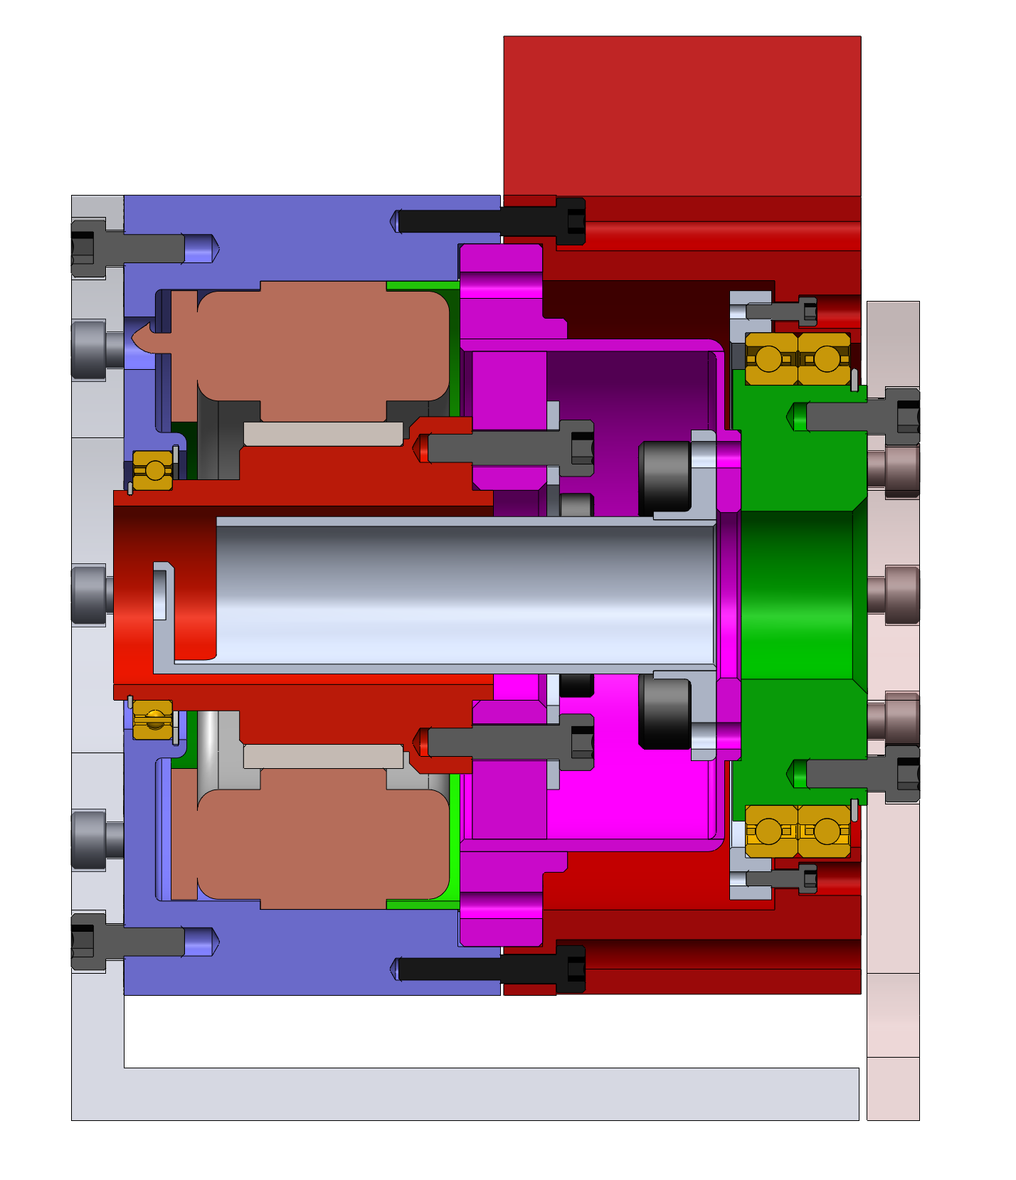
7/9/2019 update
Assume if we get proper heat sinking, 0.3m^2 convection surface area, wondering if you have good suggestion of heat sinking?
Pretty set on the double tapered bearing, for moment load. pretensioned double bearings available.
Simplest way to connect legs (brackets), willing to change if there’s better solution

Slide 25
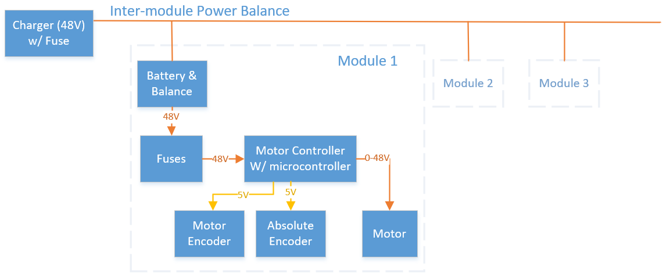
Electronics - power

Slide 26
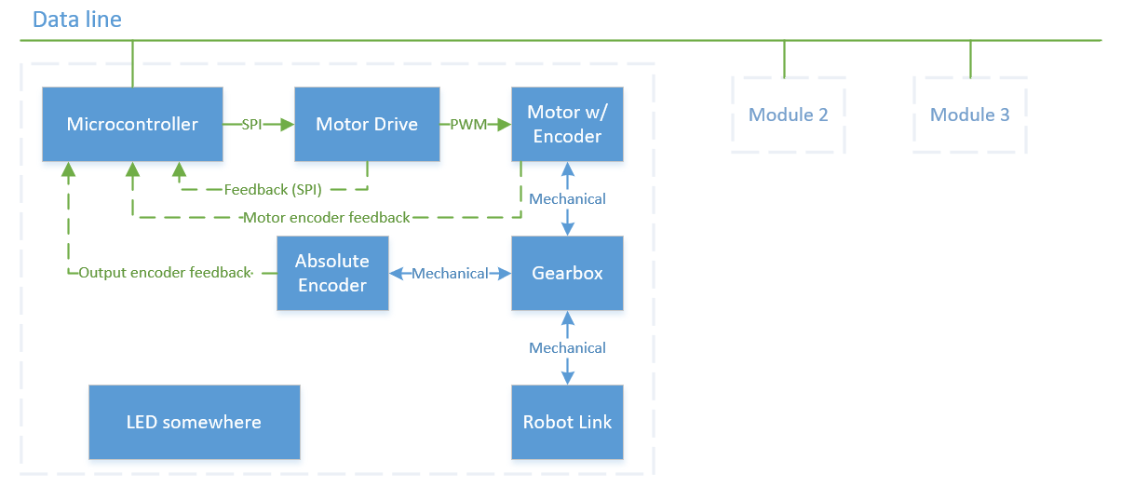
Electronics - Data

Slide 27
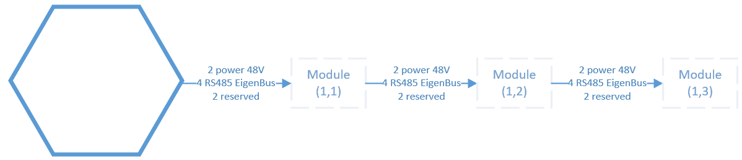
Electronics - Wire

Slide 28
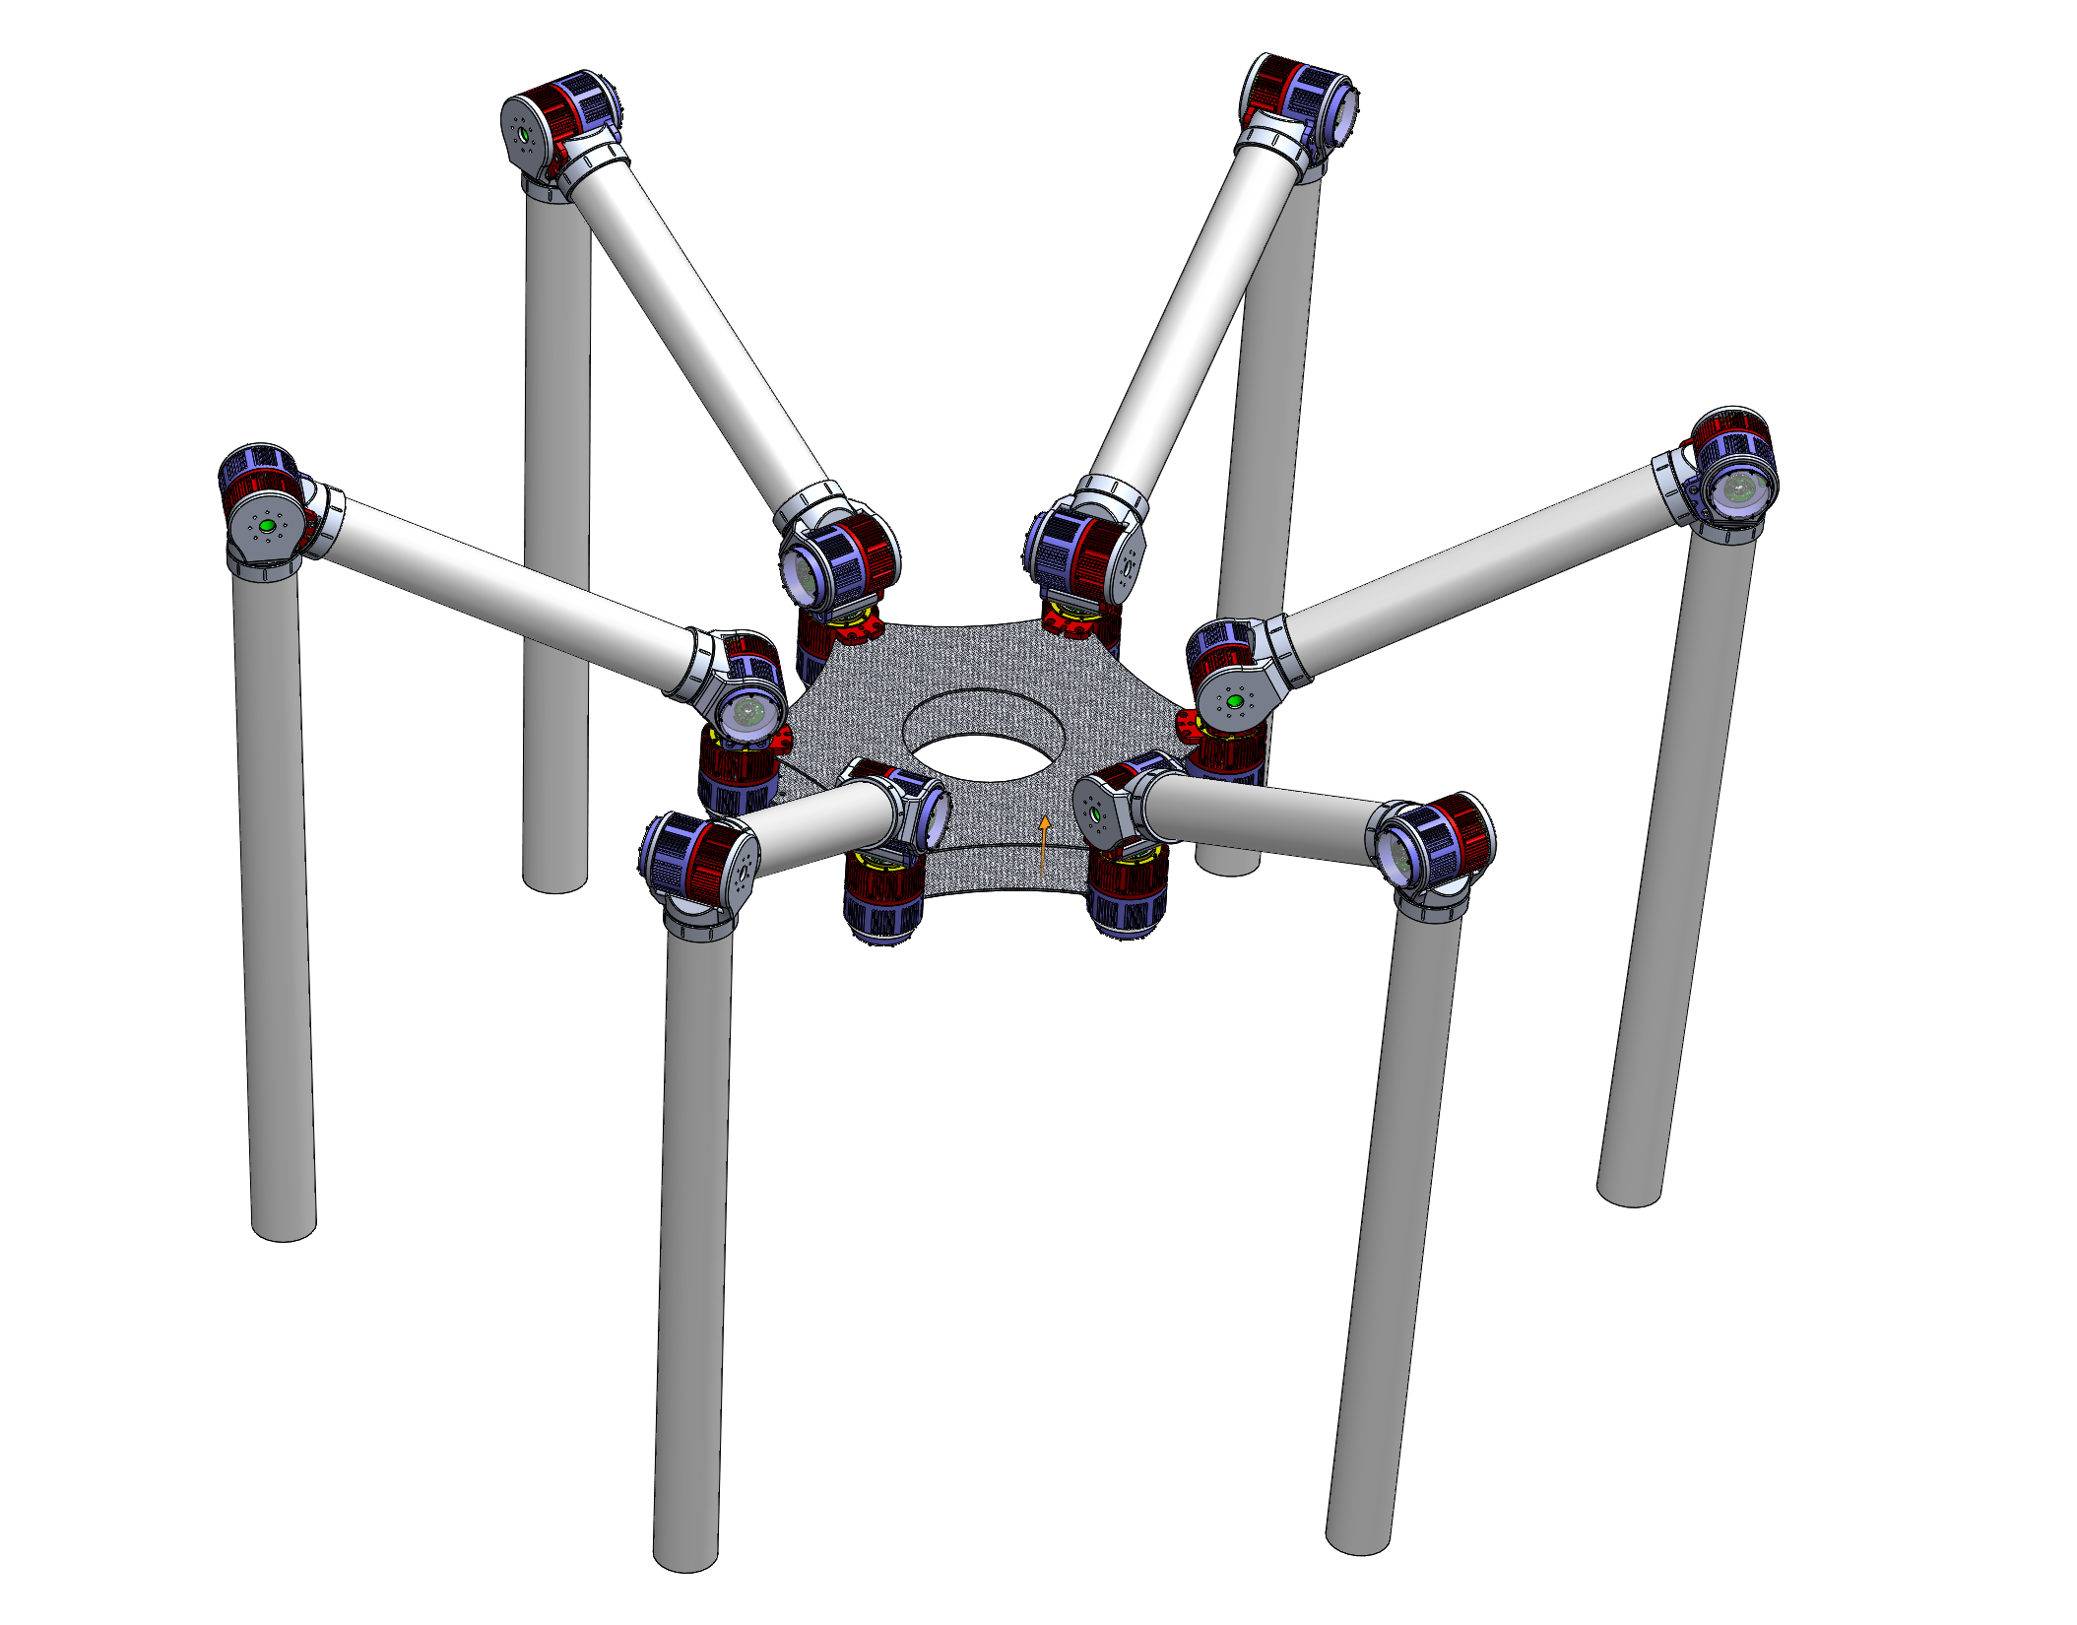

Slide 29
Fab parts quote (1 unit)
Qty: 1
 | Atomatic | Conturo
Bearing Tensioning Ring | 350 | 437.5
FlexSpline_clamp_plate | 350 | 525
Gearbox Housing | 1100 | 1399.5
Motor_Housing | 1500 | 1575.5
Motor_hub_shimpo | 525 | 541.5
Motor_space_ring | 275 | 330
Output_plate | 650 | 703.5
Per Unit | 4750 | 5512.5
Total | 4750 | 5512.5

Slide 30
Fab parts quote (3 units)
Qty: 3
 | Atomatic | Conturo
Bearing Tensioning Ring | 300 | 240
FlexSpline_clamp_plate | 275 | 269
Gearbox Housing | 950 | 693.5
Motor_Housing | 1400 | 779
Motor_hub_shimpo | 475 | 319
Motor_space_ring | 225 | 145
Output_plate | 550 | 381
Per Unit | 4175 | 2826.5
3 Units Total | 12525 | 8479.5

Slide 31
Fab parts quote (20 units)
Qty: 20
 | Atomatic | Conturo
Bearing Tensioning Ring | 100 | 76.5
FlexSpline_clamp_plate | 100 | 79.5
Gearbox Housing | 550 | 314
Motor_Housing | 750 | 389.5
Motor_hub_shimpo | 200 | 91
Motor_space_ring | 95 | 60.5
Output_plate | 250 | 138.5
Per Unit | 2045 | 1149.5
20 Units Total | 40900 | 22990

Slide 32
Fab Parts Quote (25 units)
Qty: 25
 | Atomatic (ea) | Conturo (ea)
Bearing Tensioning Ring | 90 | 74
FlexSpline_clamp_plate | 90 | 77
Gearbox Housing | 500 | 291
Motor_Housing | 700 | 365
Motor_hub_shimpo | 185 | 87
Motor_space_ring | 90 | 57
Output_plate | 235 | 133
Per Unit | 1890 | 1084
Total | 47250 | 27100

Slide 33
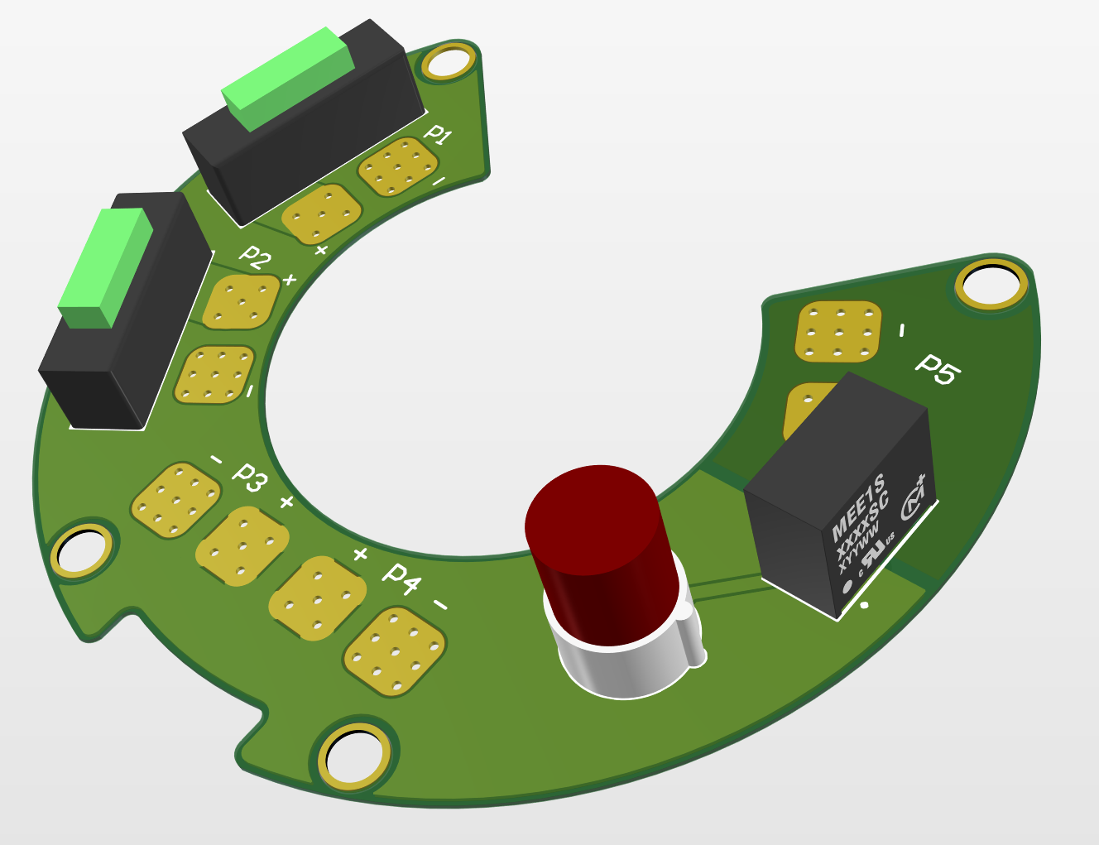
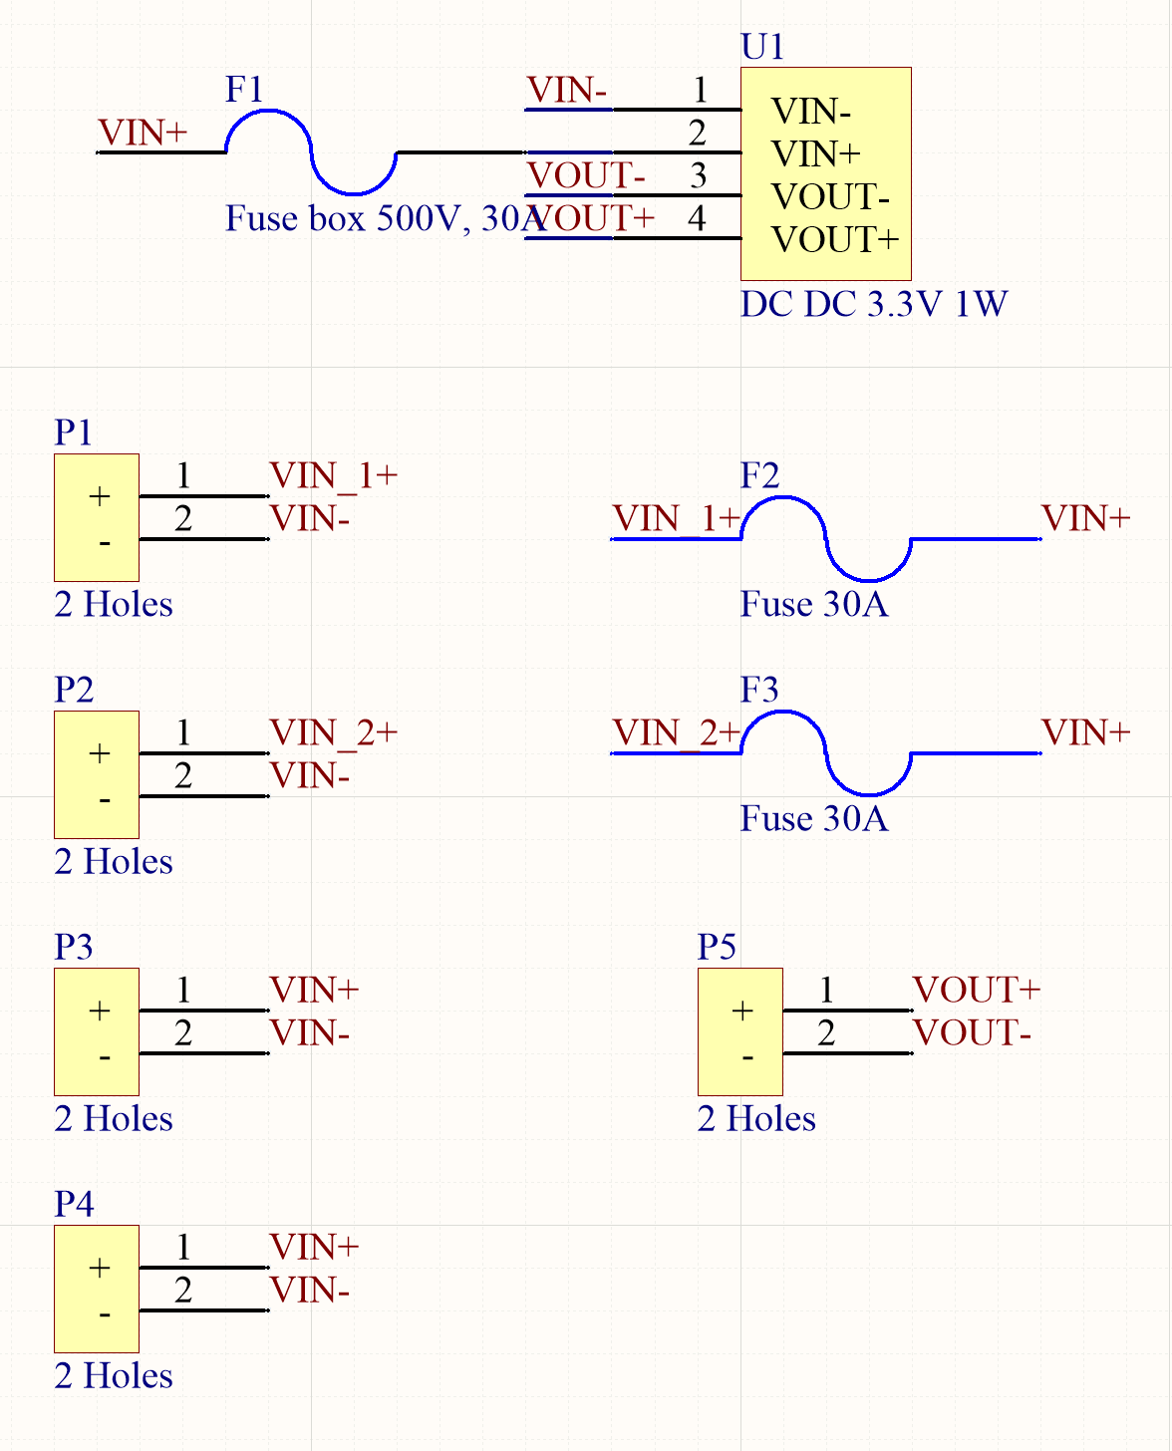
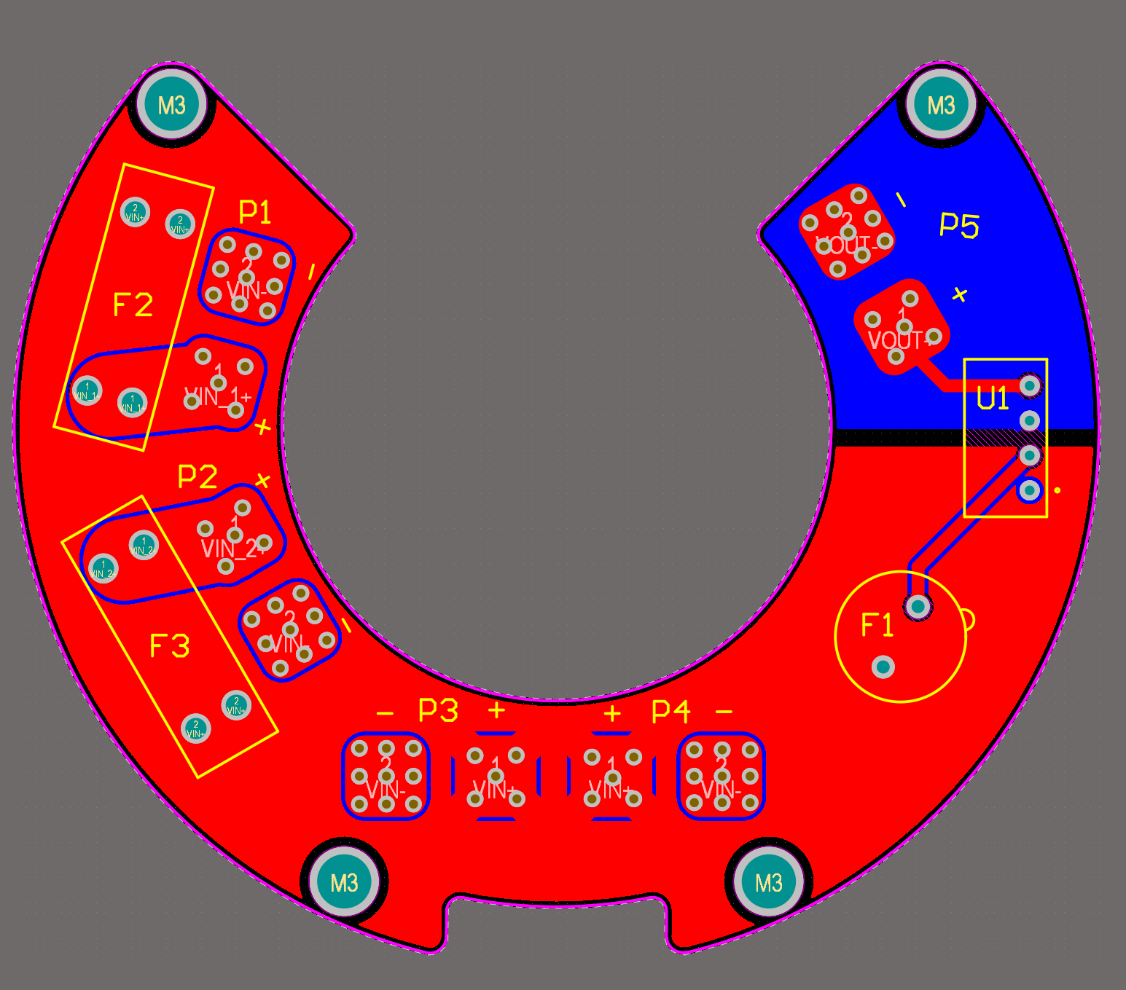
Power Distribution Board

Slide 34
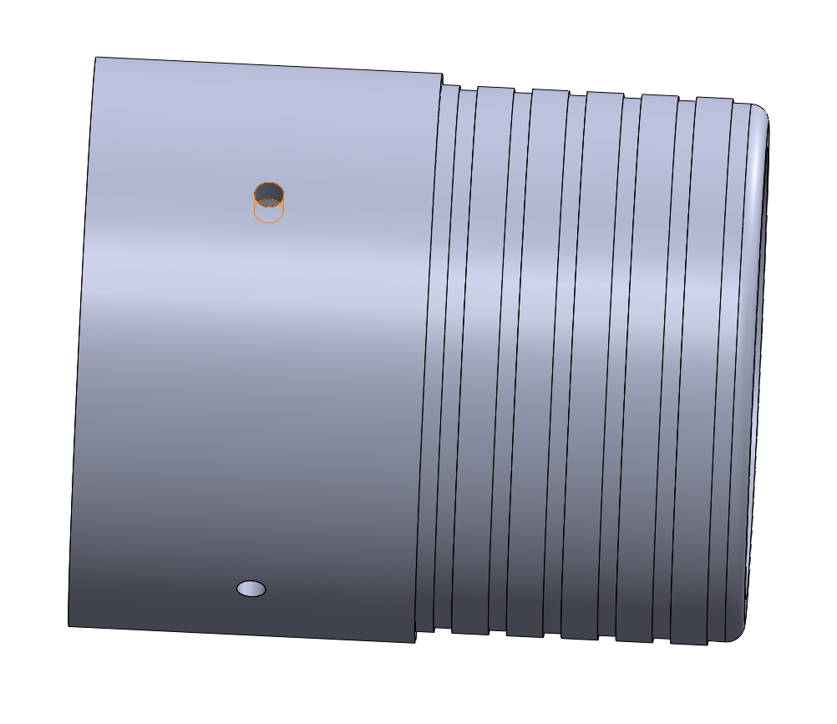
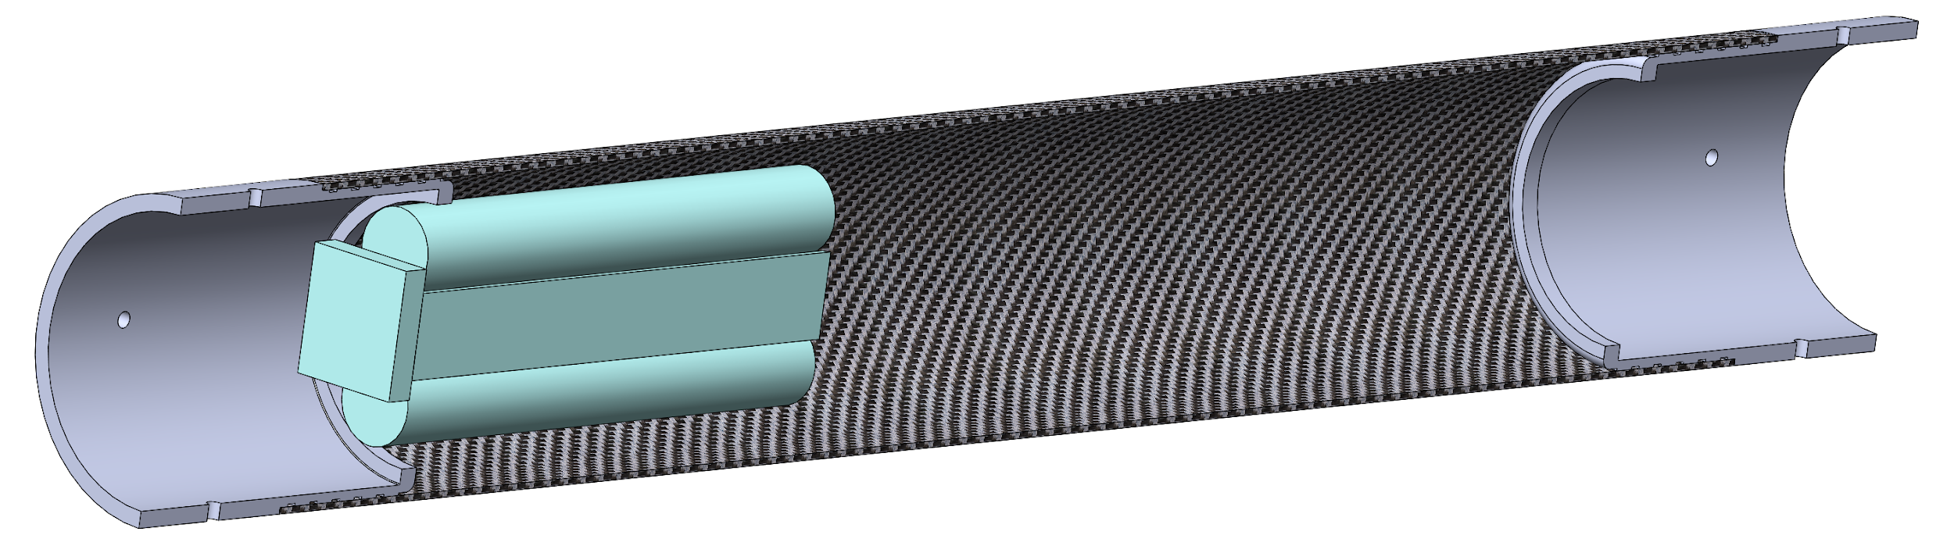
Battery Mount

Slide 35
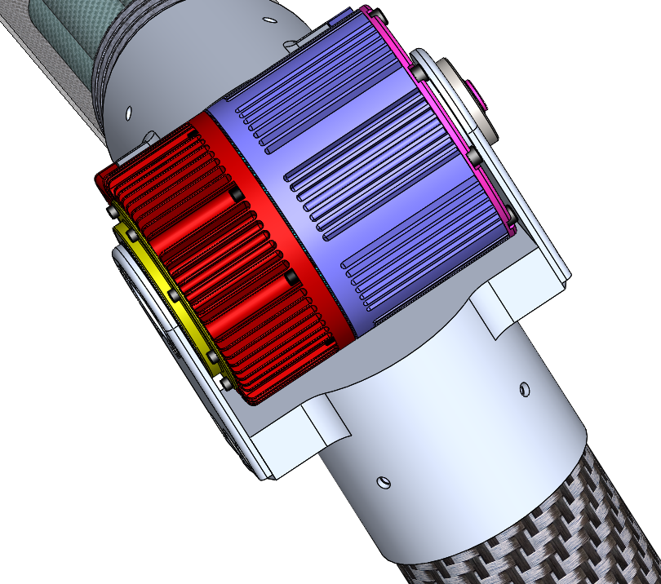
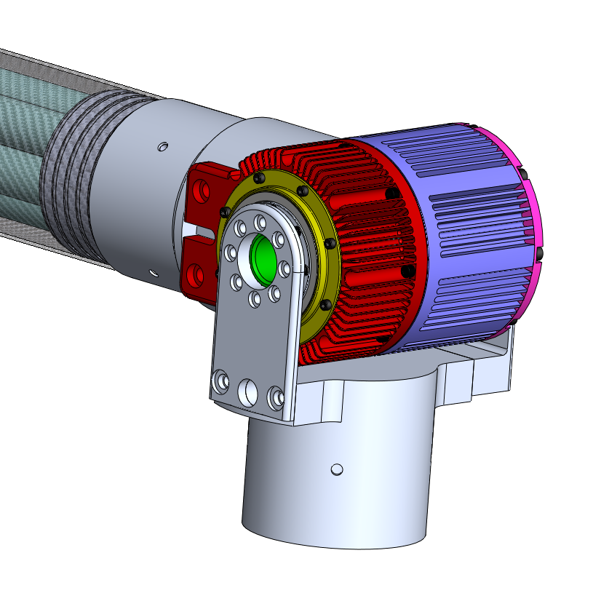
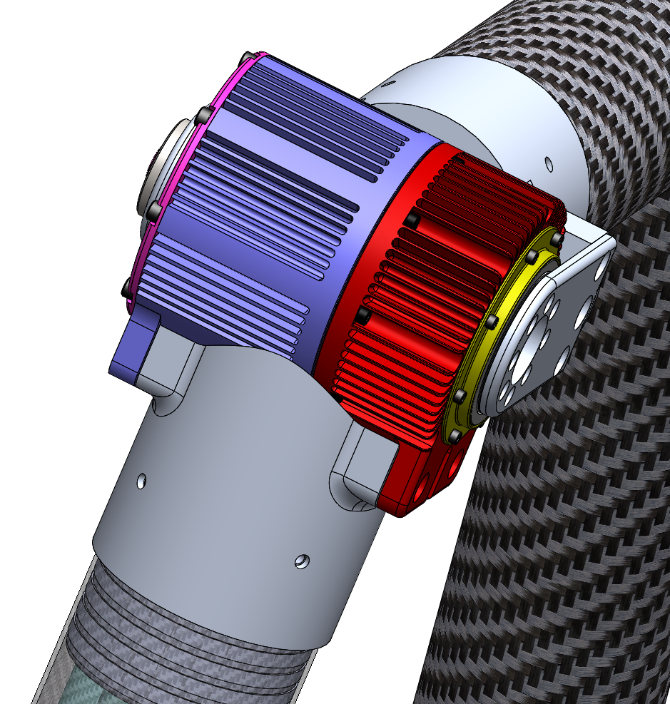
Leg mount

Slide 36
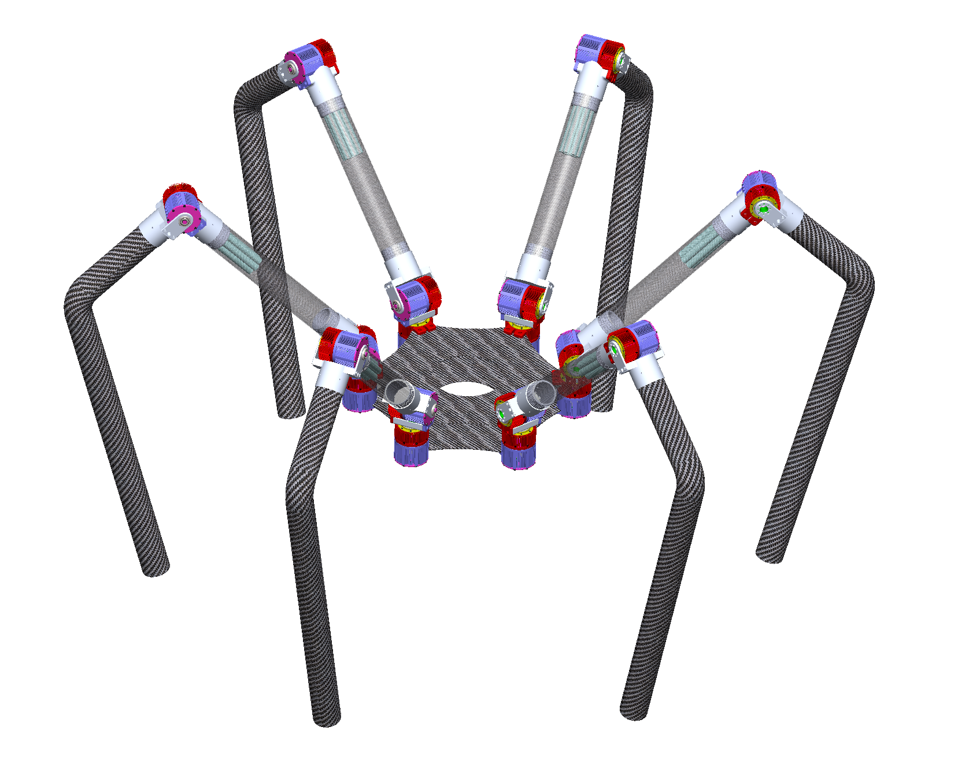
Notes:
calculate battery life

Slide 37
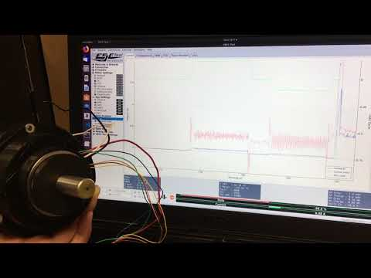
Motor + driver test

Slide 38
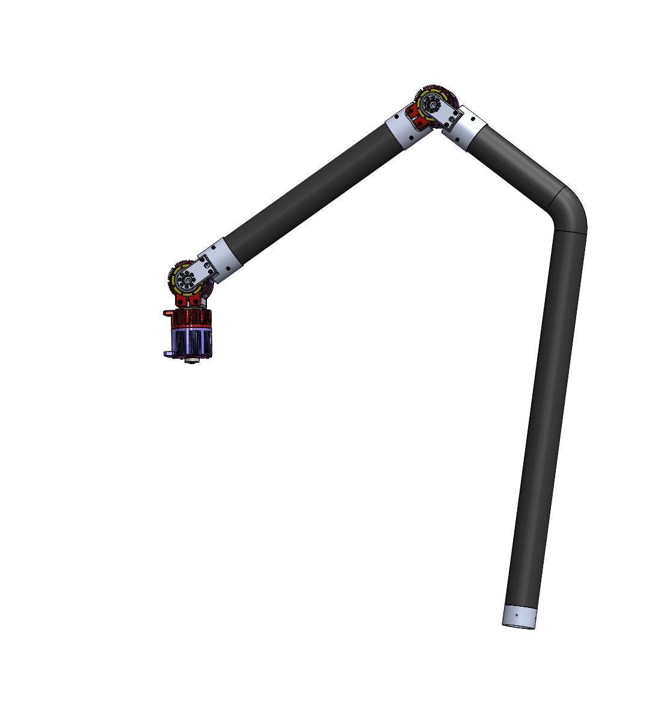
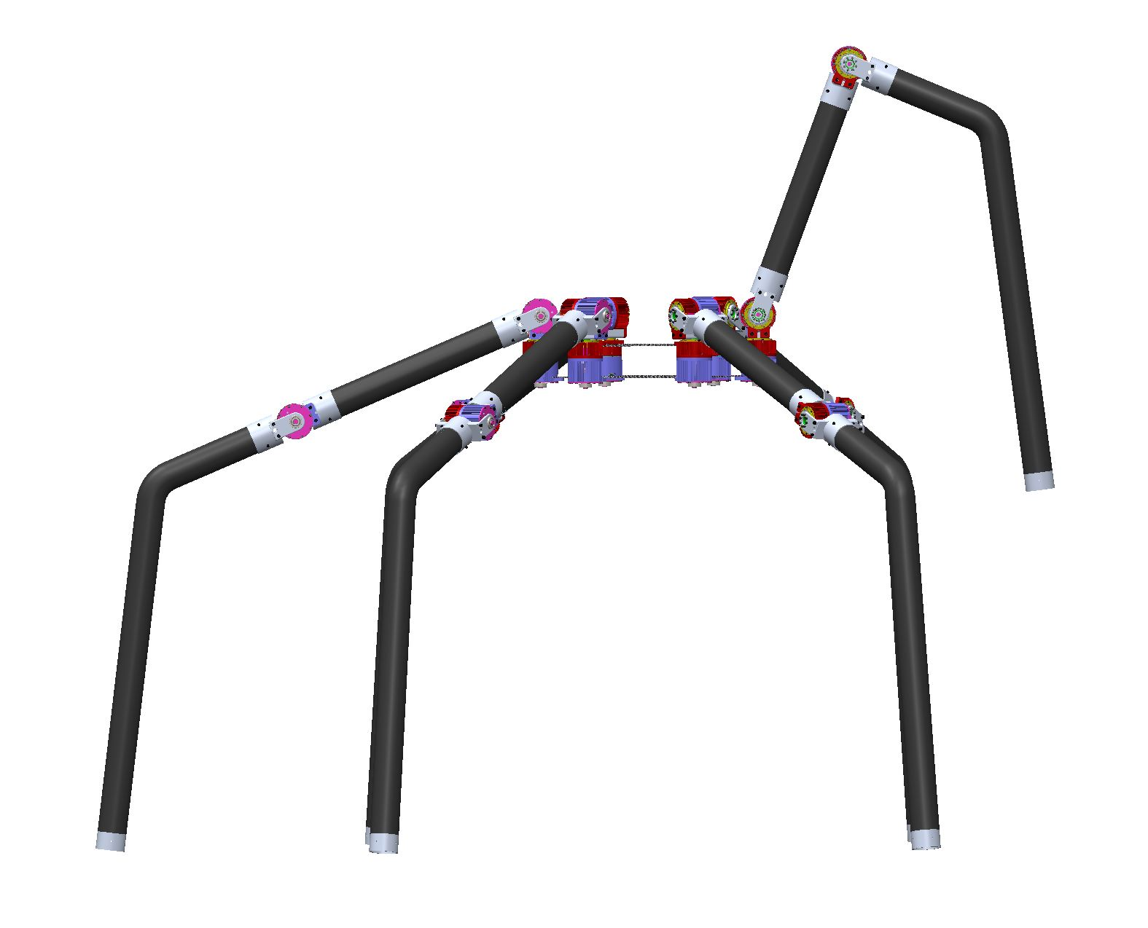
Robot Leg Length
0.25m
0.5m
1.14m
0.9m
1m

Slide 39
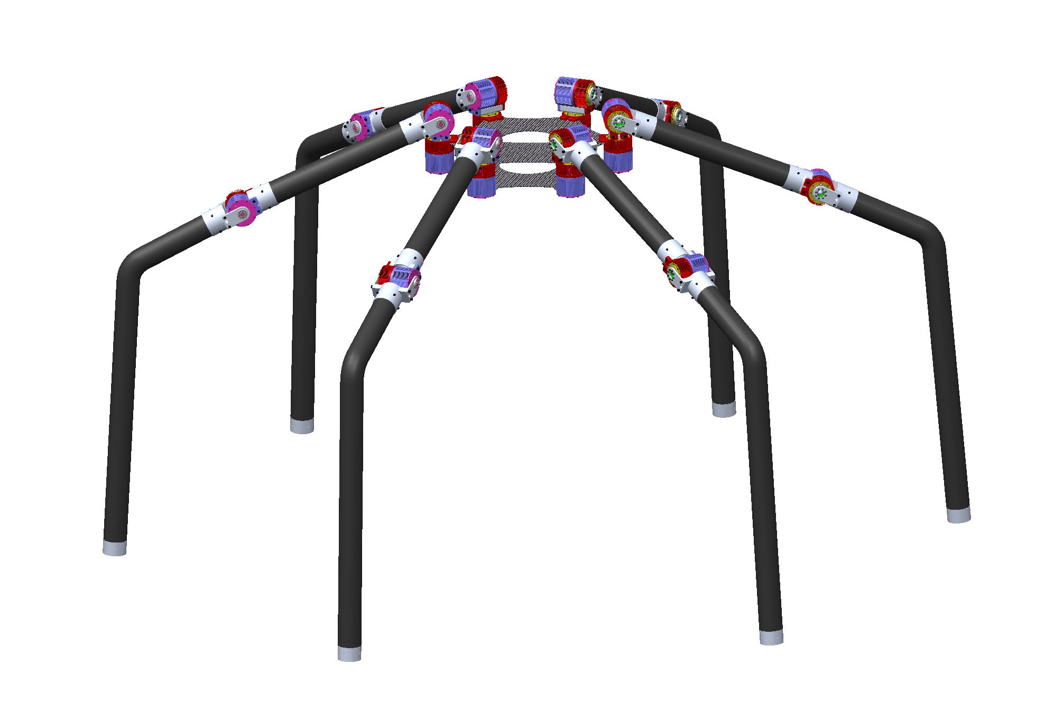
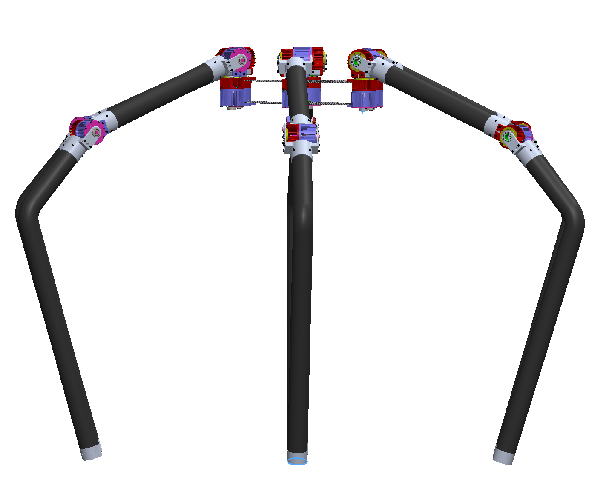
Robot Height Vs Barrier Size
 | Matt 6 | N = 6 | O = 6
Knee Height | 0.3m | 0.8m | 1.14m
Body Tallest Stance | ~0.4m |  | 1.3m
Barrier | <0.3m? | - | <1.3m
Limit Factor | Joint | Joint | Body Height
Tall Stance (a) 1.13m
Tall Stance (b) 1.35m

Slide 40
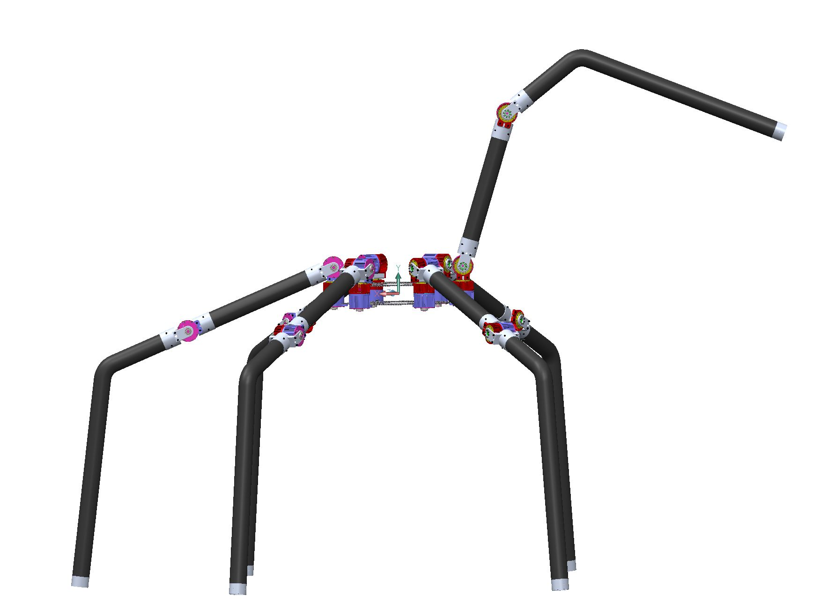
How to Reach Across?
1.3m

Slide 41
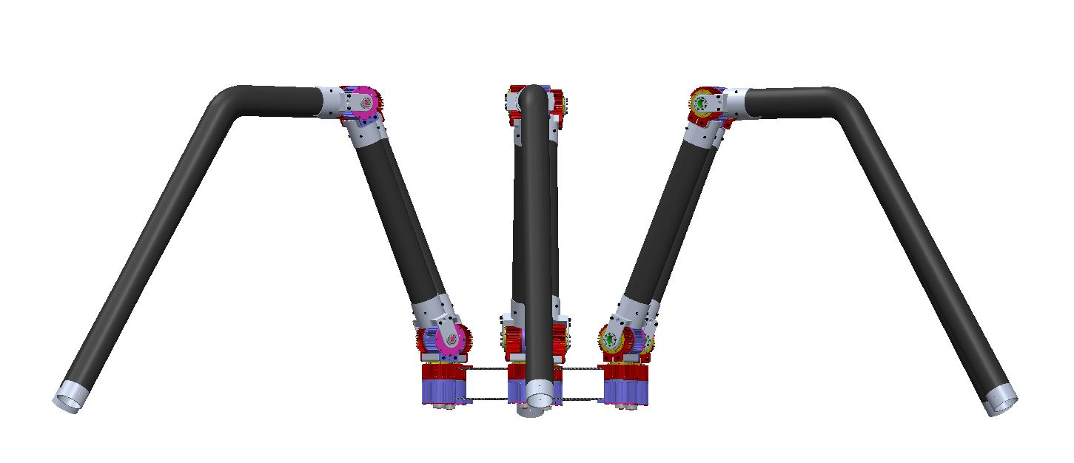
Sitting

Slide 42
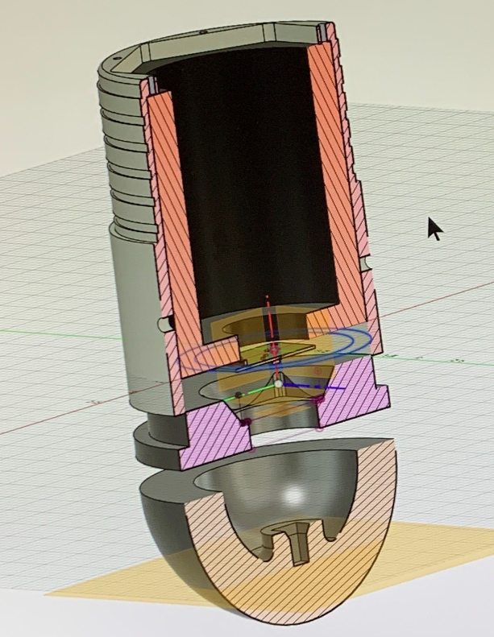
Robot Foot (Design and print)

Slide 43
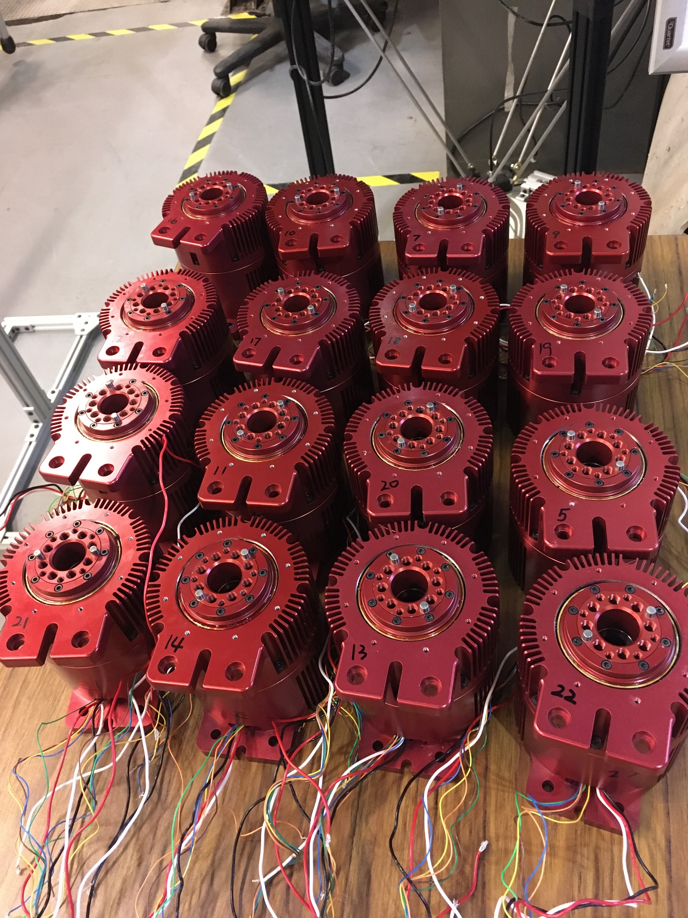
Joint Assembly
Assembly Procedure
Titan 6 BOM
(under O6 BOM Tab)

Slide 44

One Leg Assembly and Testing

